Slide 1

Be Red Cross Ready
Notes:
Begin by introducing yourself and what you do for the Red Cross. Thank the audience for inviting the American Red Cross out to help them, their family, and their fellow employees learn about disaster preparedness.
Show the emergency exits in the room.

Slide 2
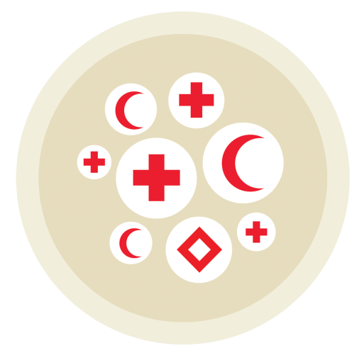

What is the Red Cross?
World’s largest non-profit humanitarian organization
Notes:
-Red Cross Movement is the largest humanitarian network in the world… in 180 countries… with 117 million volunteers and employees worldwide.
-Established by Clara Barton in 1881, American Red Cross has been the nation's premier emergency response organization.
-Primary Goal… preventing and relieving suffering.
-We are not a government agency. Funded by the donations of the American people and companies.
-Our local chapter, Northern California Coastal Region has hundreds of volunteers that are critical to our mission delivery.

Slide 3
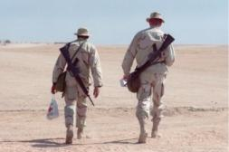
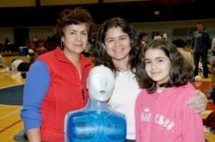
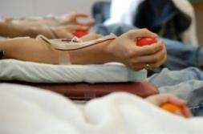

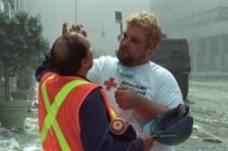
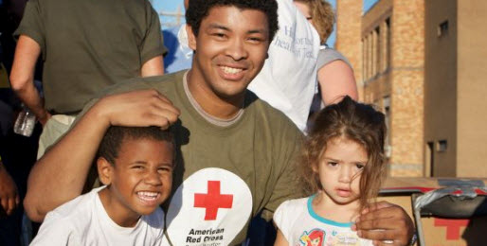
What We Do
Service to Armed Forces
Health and Safety
Blood Services
International Services
Youth Services
Disaster Cycle Services
Notes:
-“Our mission at the American Red Cross is to prevent and alleviate human suffering in the face of emergencies by mobilizing the power of volunteers and the generosity of donors.”
Service to the Armed Forces-We provide support, comfort to military and their families.
International Services-We provide humanitarian aid worldwide.
Blood Services-We collect, process, and distribute nearly half of the nation’s blood supply.
Youth Services-We teach disaster preparedness to youth of all ages.
*Health and Safety-teach CPR, First Aid, water safety classes.
Disaster Cycle Services-We open shelters, feed and care for survivors and help them get back on their feet.

Slide 4
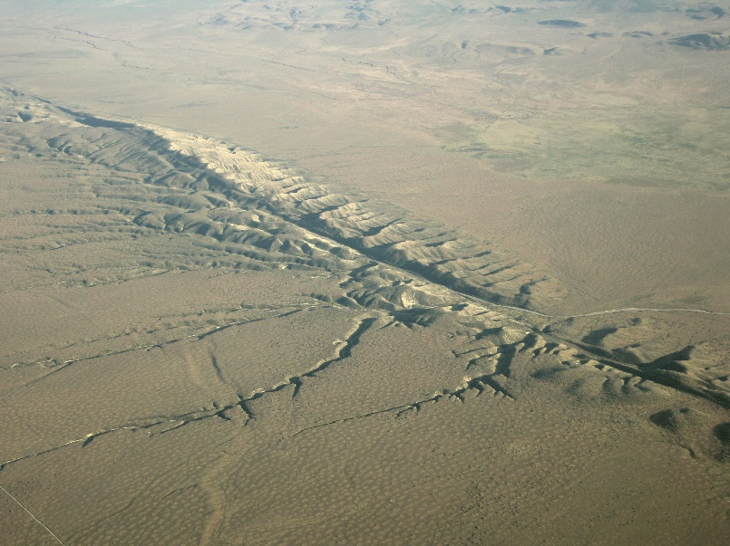
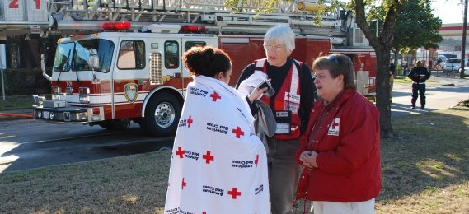
What emergency situations can happen in our area?
Earthquakes
Wild Fires
Flooding
Notes:
“Who can name some common emergency situations that can happen here?”
Talk about recent events (disaster related) in the news.
Earthquakes and fires are the 2 most common emergency situations in California.
Transition into Be Red Cross Ready. “Now that we have gone over the emergency situations we might experience here in California, let’s talk about preparing for them.

Slide 5
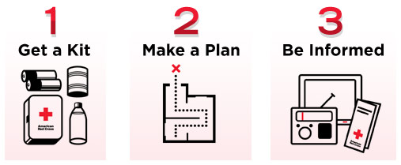
Be Red Cross Ready
Notes:
Introduce the 3 Steps to being prepared.
Get a Kit
Make a Plan
Be Informed

Slide 6
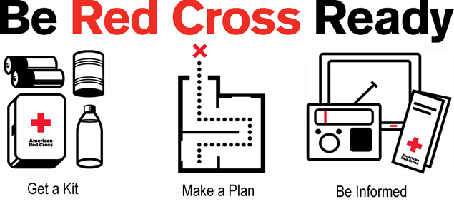
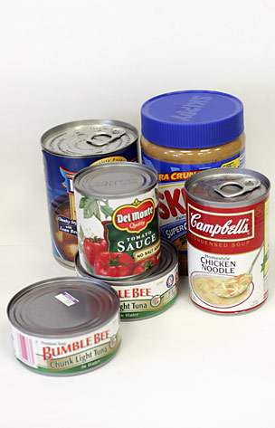
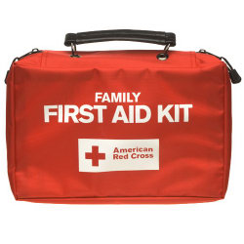
1. Get a Kit
Recommended Supplies
Water: 1 gallon a day per person for 3 days
Food: non-perishable, canned, dried; can opener
Medication, prescription and non-prescription
First Aid Kit
Flashlight + batteries
Battery-powered radio/crank radio
External battery pack
Notes:
Ask audience “What are some essentials that you would put in your kit?”
Water – 1 gallon per person per day. For drinking, washing, cooking, cleaning wounds, etc.
Food – non-perishable goods such as canned goods, dried foods, granola bars, candy bars, etc.
Ask “What kind of food what you put in your kit?”
Prescription Medication – include 1 week of medications you take daily along with written prescriptions, daily amounts, physicians names, and directions.
Flashlight and batteries – Keep batteries taped to outside of flashlight to ensure they will work. They may drain or rust if they sit in the flashlight for long periods of time.
First Aid Kit – for minor wounds from the emergency situation. It’s very important to be able to treat minor wounds to ensure they don’t become infected and escalate to a larger issue that requires medical attention.
Battery-powered Radio – most emergency information will be broadcasted via the radio. It is likely that internet and power will be down so the radio may be your only source of information.
External battery pack – to charge cell phones
6

Slide 7
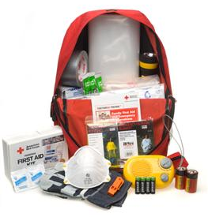
1. Get a Kit
Other supplies:
Toiletries & sanitation supplies
Blanket
Cash and coins
Important papers
Notes:
Red Cross recommends being prepared for at least 3 days. It will likely take this long for relief services to reach you in a large-scale emergency situation. If possible prepare for 1-2 weeks.
Ask audience “What are some other things you would put into your emergency situation supplies kit?”
Repeat audience answers for everyone to hear.
Describe each item.
Toiletries and sanitation supplies– soap, shampoo, conditioner, toothpaste and toothbrush, etc.
Cash and coins – small bills. It is likely the ATMs will not be working and you will have to purchase goods in cash. It is likely the stores will not have change. You do not want to pay $100 for a bottle of water.
Important Papers – house deeds, insurances, ID, passport, prescription medications, etc. In addition to having this in your kit it is also a good idea to have copies of these in a digital form and uploaded to a Cloud platform or a flash drive.
Reinforce how easy and inexpensive putting together a kit can be. “You can use anything – plastic bags or even a bucket. Often we have most of these items at our houses already.”
Tell the various places you might want to have a kit.
At home
In the car
At work

Slide 8
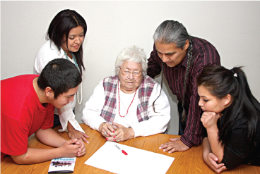
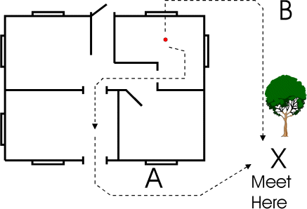
2. Make a Plan
Talk
Talk with members of your household
Learn each person’s needs and abilities
Assign roles and work together
Plan
Two exits out of your home
Two meeting locations
  Near home
  Outside neighborhood
Out-of-state contact
Practice
Practice earthquake and fire drills twice a year
Participate in the Great Shakeout in October
Notes:
Transition into step 2, making a plan. “Next, let’s learn how to make a plan. If you get this far, you are doing better than most. 70% of people do not have escape plans for their homes!”
Teach the steps to making a plan.
Talk to members of your household about possible emergency situations and how you will respond together in such an event to ensure everyone’s safety. Discuss any special needs people may have and what each person’s role in a emergency situation will be.
Plan two meeting locations & two exits from every room. Make a drawing for the refrigerator so everyone remembers the evacuation plan.
You should have two exits from every room. In case you can not evacuate through one exit due to a fire or damage from a natural disaster you will still be able to evacuate through the other room.
You should have two meeting locations. One meeting location should be directly outside your home in the case of a house fire or other home emergency. The second meeting location should be a few blocks away from your home (ex: at a park or grocery store). This meeting spot is used in the case of a large emergency situation where you must evacuate the entire neighborhood.
Discuss two routes out of your city as well, as major routes may be inaccessible during an emergency situation.
Develop a communication plan, with an out-of-state-contact.
In a large emergency situation, it is likely that you will not be able to get a call through locally because the phone lines will all be busy. However, the long distance phone lines are different and you should be able to get through with a long distance call. Choose a family member or friend who lives out of the area to be your emergency contact.
It is also helpful to text because texting takes lower bandwidth and may go through even if you can’t get a call through.
Stop! Give audience 15 seconds to write down as many phone numbers as they remember.
Distribute wallet cards and have participants start filling them out as the first step towards making a plan. “Today most of us don’t remember many phone numbers since they are programmed into our phones. It is important for us to have important numbers written down so that in the case of an emergency if our phone dies and there is no power we still are able to contact our loved ones.”
Recommend practicing drills and reviewing your plan once to twice a year.

Slide 9
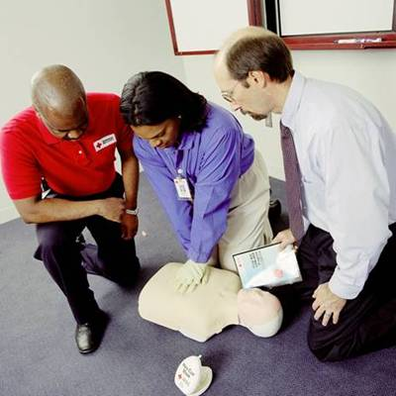
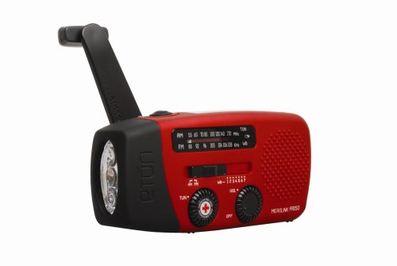
3. Be Informed
Information Sources
Television
Radio
Internet/Social Media
Telephone/Text Message
Local Emergency Warning System
Other people
Other Ways of Being Informed
First aid and CPR
Earthquake safety
Fire safety
Practice your plan
Notes:
Transition into step 3, being informed. “Now we have both a kit and plan in place. But how are we going to know what is happening during the actual emergency situation? Where can we get information about an emergency situation?”
Teach how to be informed.
Know common emergency situations in your area. As we talked about earlier likely emergency situations here are earthquakes, floods, home fires, and pandemics.
Teach how to be informed.
Learn basic first aid and CPR.
Know basic safety tips
Practice your plan
Now we are going to become better informed about the two most common emergency situations in our area.

Slide 10

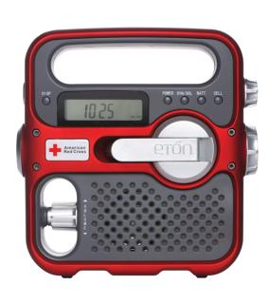

3. Be Informed
Notes:
Teach how to be informed.
Know local Radio Stations and Emergency Warning Systems that will be broadcasting emergency information.
Now we are going to become better informed about the two most common emergency situations in our area.

Slide 11
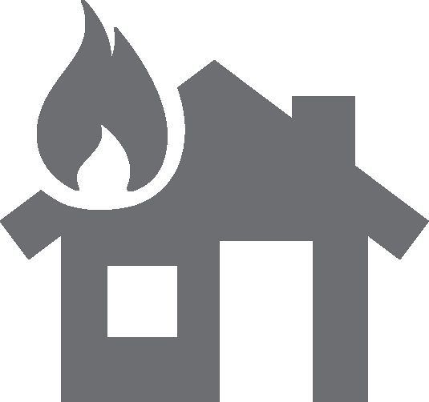
What emergency situation does the
Red Cross respond to the most?
Home Fires!
Notes:
-About 650-thousand home fires per year in the US.
-Red Cross responds to every house fire… offering aid, references and shelter.

Slide 12
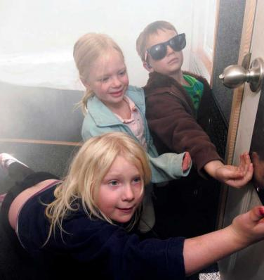
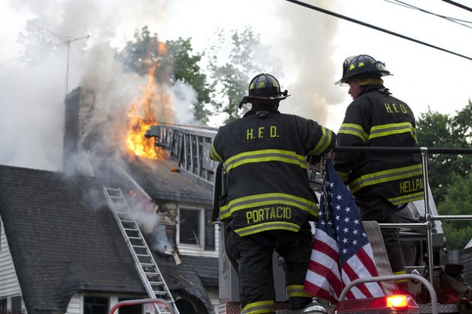
Steps to Fire Safety
To evacuate from a fire:
  Stay low to avoid smoke
  Feel closed doors with the back of your hand for heat
  Get out - stay out - call 911
If you cannot get out:
  Move to room furthest from fire
  Close the door, put cloth under the door to stop smoke
  Hang a cloth out the window to signal for help
Notes:
Describe how to safely evacuate during a fire.
Stay low and go! Smoke rises, air is cleaner closer to the floor.
Close doors between you and the fire. Feel a door with the back of your hand before going through it.
Get out as quickly as possible and do not go back in for anything. You may have less than 2 minutes to escape.
Call 911 right away.
Explain what to do if you cannot find a way out.
Try to find a room as far as possible away from the fire
Shut the door between you and the fire. This will detain the fire for up to an hour.
Put cloth under the door to stop the smoke.
Hang a cloth out of the window to signal for help.

Slide 13

Defend Against Home Fires
Smoke Alarms
Most effective defense against home fires!
Have at least one on each level of your home
Test every 6 months
Notes:
House Fires:
Most common emergency situation.
On average 1.6 million fires occur every year. Most deaths come from smoke inhalation, rather than burns. Therefore it is very important to know how to prevent a fire and know how to respond if there is a fire in your home.”
Ask audience “Who knows what the most effective defense for a home against a fire is?”
SMOKE ALARM
-Every home should have one. One on every level.
-Check the smoke alarms every 6 months. As a reminder of when 6 months comes around you can check your smoke alarms during daylight savings when you are changing the clocks.
-Replace smoke detectors every 10 years. 30% of smoke detectors do not function.

Slide 14
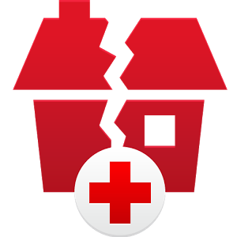
What other emergency situation is common in California?
Earthquakes!
Notes:
Transition into earthquake preparedness.
Explain high likely hood of earthquakes here in California. 73% chance of Loma Prieta sized earthquake occurring between now and 2043.
Explain that most injuries occur not from buildings collapsing, but from items falling of walls, shelves, etc.

Slide 15
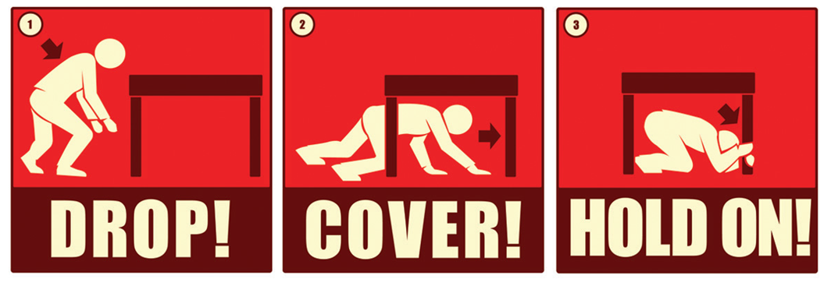
What do you do during an earthquake?
Notes:
Explain “Act quickly. Do not wait to see if the shaking gets worse.”

Slide 16
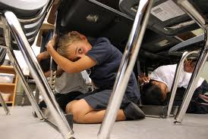

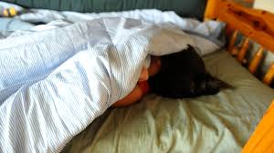
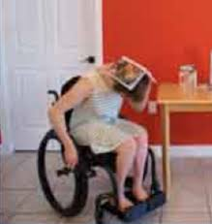
If you are inside…
Drop, Cover, & Hold On…
Under a sturdy table, desk, or other object
By an interior corner or wall
If in bed, cover head with pillow
Notes:
-Drop, cover, and hold on under a sturdy table or object. If there is no table, find an interior corner or wall that isn’t close to any windows or large objects and sit down covering your neck. If you are in bed, stay in bed and cover your head with a pillow.”
-Historically the doorway was the strongest part of a building. During that time there was the possibility of a building collapsing on you. Under these circumstances a doorway would be the safest place. Today in America, our buildings are built to withstand earthquakes. It is unlikely they will collapse. Your greatest risk is falling debris and glass. Being under a table or chair nearby will protect you from this.
(Special note for seniors and special needs. If you cannot get to the ground, stay in your seat and protect your neck and head. Stress that they should not try to move, because falling can cause serious injuries. Please refer to your booklet for more information.)

Slide 17
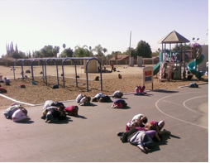

If you are outside…
Drop & Cover
Open space is best
Away from buildings, trees, telephone lines, etc.
If there is a down power line near you, do not go near it & call PG&E.
If driving…
Pull over in an open space
Stay in your car
Notes:
“Find an open space away from buildings, trees and power lines.”
Driving - pull over and stop, but stay in the car. If you are on a bridge, try to get off if possible. If not, pull over and stop driving until the quake finishes. Then proceed with caution.”
Reinforce that one should not try to move since the earth may be shaking, rolling, or undergoing liquefaction.

Slide 18
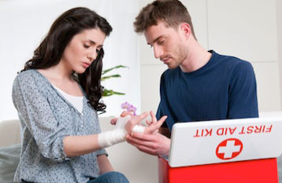
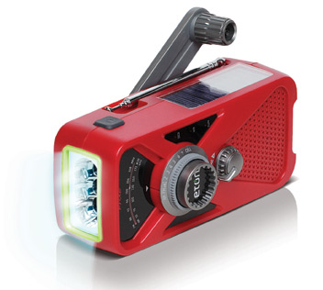
After an Earthquake
Check yourself for injuries,
then help those injured
or trapped around you.
Stay tuned to local radio for information
Stay out of damaged buildings and return home only if authorities say it is safe
Leave the area if you smell gas or chemical fumes
Notes:
After an Earthquake.
Be prepared for aftershocks within the first hours, days, weeks and even months after the quake. Although smaller than the main shock, aftershocks can cause additional damage, and may collapse already weakened structures.
Family members should help injured or trapped persons, giving first aid when appropriate. Do not move seriously injured persons unless they are in immediate danger of further injury. Call for help only to report a life-threatening condition. The phone lines need to remain available for true emergency calls.
Stay tuned to local radio for the latest emergency information.
Stay out of damaged buildings and return home only if authorities say it is safe.
Leave the area if you smell gas or fumes from other chemicals.

Slide 19
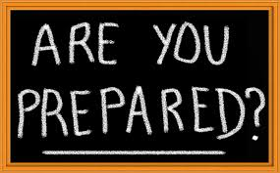
What Can You Do Today?
Start your kit
Sign up for a CPR and First Aid class
Share your preparedness knowledge with members of your household
Practice your escape plan
Notes:
Today we have learned a lot about how to prepare for earthquakes, fires, and other emergency situations. It may seem like a lot to do, but there are a few easy steps you can take today to get started. Work over time to complete the larger steps such as building a full emergency situation kit. Taking these steps will help you be safer, calmer, and more able to endure a large scale emergency situation.”
For a fire, you can prepare by
Testing your smoke alarm
For an earthquake, you can prepare by
Practicing “drop, cover, and hold on”

Slide 20
Contact
Local
  James.cooper@redcross.org
  http://www.redcross.org/local/california/northern-california-coastal
For general inquiries
  getprepared@redcross.org
Notes:
Wrap-up by asking the audience if they have any questions. Refer them to local Red Cross chapter office. Thank everyone for taking the time to learn about personal disaster preparedness.

