Slide 1
Napa Valley COAD
Crisis Communications Workshop
July 10, 2018

Slide 2
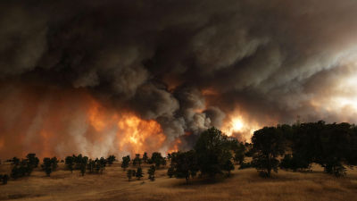
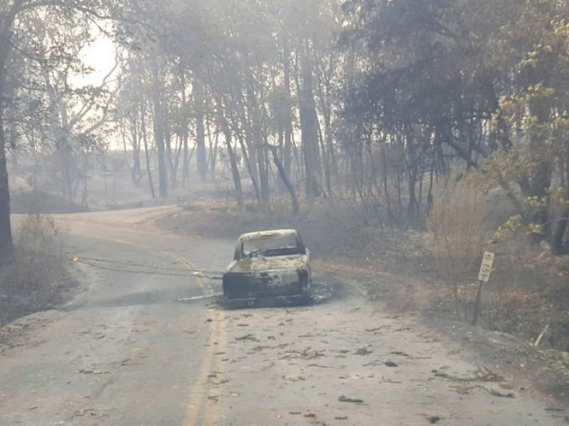
Workshop Agenda
Purpose of the Workshop: To Explore the Elements of a Crisis Communications Plan
Crisis Communications Activities & Functions
Communication Systems, Methods and Tools
Developing Multi-lingual and ADA Capabilities
Coordination with Local Government

Slide 3
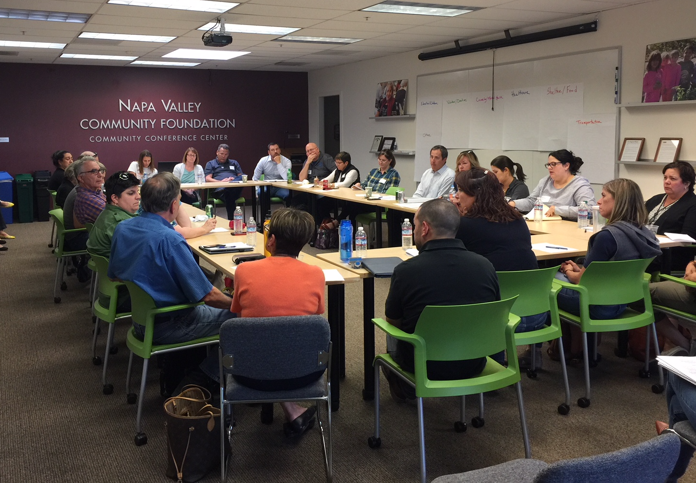
2018 Fires
What worked well and what could be improved related to Crisis Communications?

Slide 4
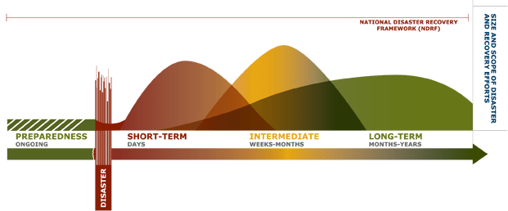
Response Timeline
Continued Response
72 hours – 2 weeks
Long-term Recovery
2 months – years
Initial Response
First 72 hours
Short-term Recovery
2 weeks – 2 months

Slide 5
Crisis Communication Activities
Day to Day Functions:
Coordinate non-emergency information to share with your clients, including information such as:
Planned events
Special opportunities
New and existing services
Resources
Job fairs
Volunteer opportunities
Hours of operation for services
Other important daily information
Maintain a state of readiness to support alert & warnings in the event of a no-notice emergency (i.e. earthquake) by developing protocols and conducting exercises

Slide 6
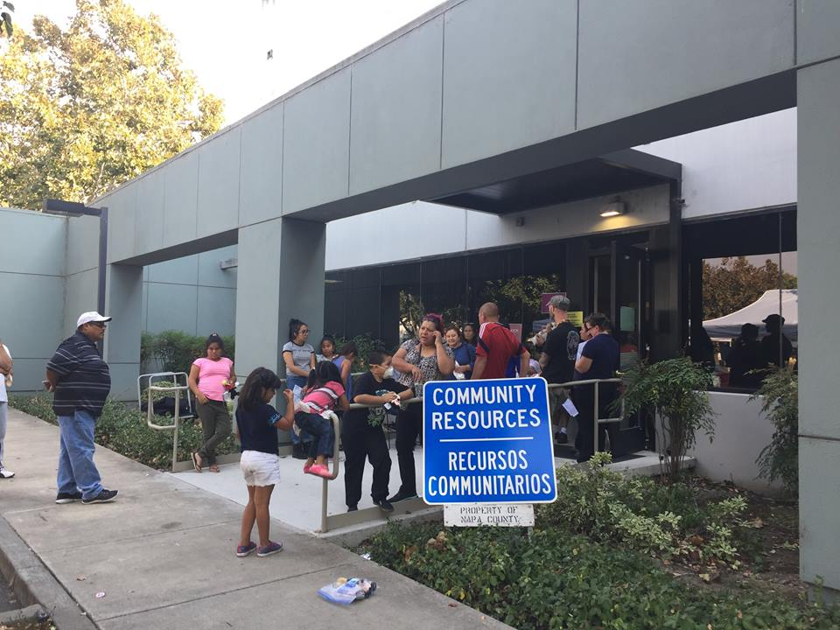
Crisis Communication Activities
Emergency Coordination Activities:
Gather and Share Situational Awareness
Coordinate messaging of services with partner agencies
Media Management as it pertains to your agency
Participate in Community Meetings
Media/Social Media Monitoring
Message Development
Message Distribution
Mutual Assistance
Collect and share “stories”
Coordinate with the County PIO
Determine if your agency would need a “call center”

Slide 7
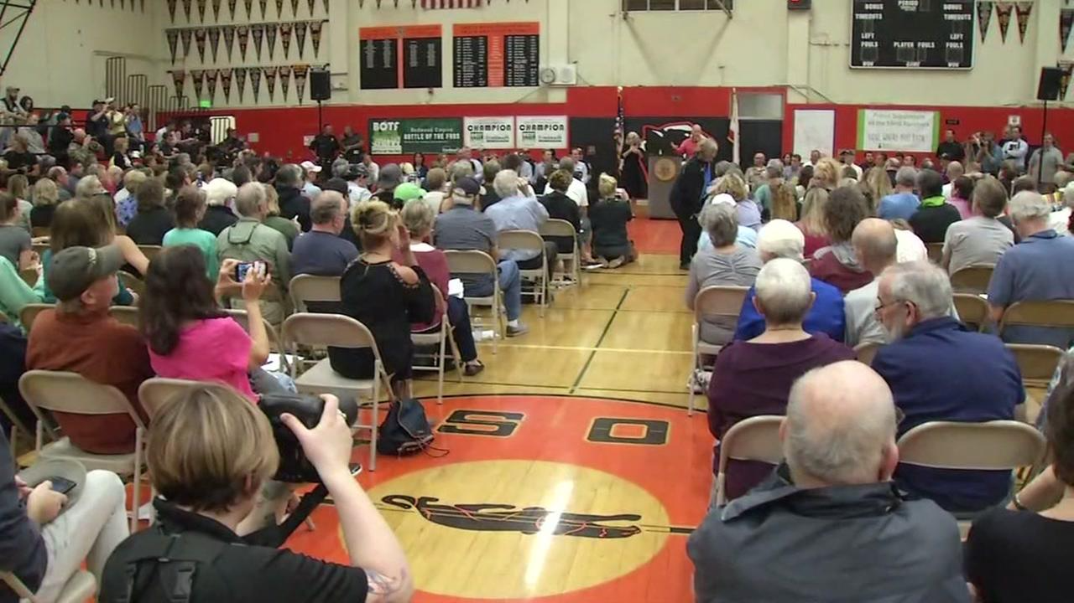
Crisis Communications Functions
Information Analysis
Receive validated information from local government and emergency service providers
Compile services being provided that may help your clients (LAC, Shelters, POD locations)
Provide information for Community Meetings
Internal Communications with staff
Establish an Emergency Public Information Line and staff it with employees to respond to public request for information if needed
Ensure multilingual capabilities for a Call Center or line dedicated to disaster response

Slide 8
Crisis Communications Functions
Messaging
Write and customize messages
Have messages approved
Need technical writing experts
Update your website website with information and resources
Create disaster-specific websites if needed, such as a recovery website
Media
Deliver messages via multiple media outlets
Provide information for Community Meetings
Monitor Social Media
Disseminate social media
Bilingual staff who are media trained is critical
Technology
Specialize in crafting succinct messages for Alert and Warning
Bilingual staff critical

Slide 9
Communication Systems, Methods, Tools
Nixle is a Community Information Service that allows government agencies to send messages to local residents via phone, email and web
Opt-in System - Individuals HAVE TO sign up for the system in order to receive notifications
Integrated Public Alert & Warning System (IPAWS), operated by FEMA is the gateway to activation of the two national public warning systems, such as: the Emergency Alert System and WEA.
Opt-out System - you will automatically receive alerts, for example, an Amber Alert and can Opt-out when purchasing a cell phone.
Notes:
Nixle is a commercial vendor/software. It sends messages to telephone (voice), text and email data registered into the program by individuals. It has a list-driven feature in addition to selecting audiences by geographic area

Slide 10
IPAWS: Gateway to EAS and WEA
The Emergency Alert System (EAS)
National public warning system that requires broadcasters, cable TV systems, wireless cable systems, satellite radio service and broadcast providers to provide the communications capability
EAS enables County agencies to interrupt broadcasts with an emergency message up to two minutes in length
Wireless Emergency Alerts (WEA)
Can send brief text to all operating cellphones in a specified area
Available to cities as well as counties
An opt-out system – at time of phone purchase, WEA is activated, owners can choose to disable it for local alerts

Slide 11
Additional Communication Systems, Methods, Tools
Website Updates
Facebook Page
COAD Distribution List
In person Meetings
Google Resource Directory
What else?

Slide 12
Inclusivity
Inclusivity of all persons with disabilities and others with access and functional needs (AFN) is a must.
AFN populations are defined as those whose members may require special assistance and services from the non-profit and local government agencies and emergency management system before, during, and after an incident, including communication in a language other then English, or even by personal contact.

Slide 13
Reaching AFN and Vulnerable Populations
Title II of the Americans with Disabilities Act requires all emergency management programs, services, and activities accessible to everyone, including those with disabilities
Vulnerable populations:
Those who require face to face contact for notification, (i.e. homeless encampment, medically compromised) due to limited or no access to traditional communication means.
Approved accessibility tools include:
Closed captioning
TTY devices to type / receive text messages
Enhanced audio / audio video relay services
Identify and contract with local resources for auxiliary aids and interpreter services
Notes:
Emergency Notification-alerting the public to emergencies and disasters, and to notify them of available services, is a component of emergency management that is covered by ADA.
People who are deaf or hard of hearing will not hear radio, television, sirens or other audio alerts. They may have telephones fitted with special technical aids. People who are blind or visually impaired will be unable to see screens, flashing lights or other visual cues.

Slide 14
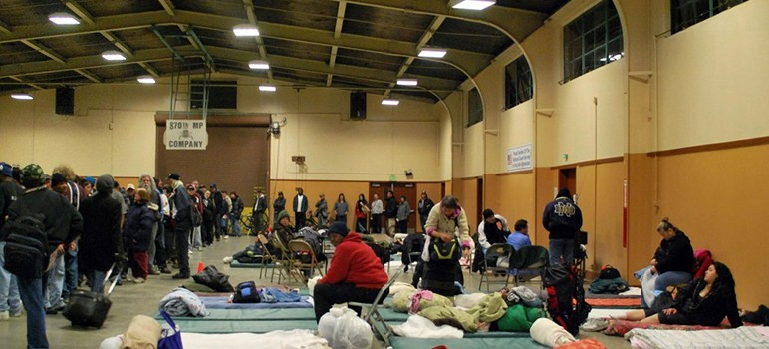
Multi-lingual Communications
Who are we talking with?
English
Spanish
Other
In what formats?
Listening and interpreting
Written and spoken
How to provide this capability?
Recruit/Assign and train staff on how to provide these resources
The need to listen and interpret information from audience sources (social media, call center, in person, etc.)
Develop messages and share (News media, social media, on camera, radio, etc.)
Provide pictorial Instructions rather than words

Slide 15
Thank You!
Kelle Kroll
kelle@kellekrollgroup.com
www.kellekrollgroup.com

