Slide 1
Whole Community Emergency Management Inclusion of Persons with Access and Functional Needs
Napa Valley
Community Organizations Active in Disaster
August 14, 2018
Prepared by:
Mike Humphrey, Manager
Sonoma County In-Home Supportive Services (IHSS) Public Authority
Chair, Sonoma County Access and Functional Needs Committee

Slide 2
Handouts
Acronym List
Disability Etiquette Handbook
Tips for Effectively Communicating with the Whole Community
Accessible Public Events/Meetings Checklist

Slide 3
It’s the Right Thing To Do, and it’s a Legal Mandate
It’s the right thing to do…
It’s also required law
Americans with Disabilities Act (ADA)
Prohibits discrimination on basis of disability
Services provided in the most integrated setting
Must include reasonable accommodation
Post-Katrina Emergency Management Reform Act
California Emergency Services Act
Several other federal and state laws

Slide 4
Whole Community Approach to Emergency Management
Historically, segregated approach…
Not so long ago, “special needs” or “medical needs”
In 2012, changed to the “Whole Community Approach”
Not only a change in terminology, but also perspective
Focus from diagnosis or demographic to life functions

Slide 5
Whole Community Core Themes
Understand the complexity of the whole community
Recognize community capabilities and needs
Foster relationships with community leaders
Build and maintain partnerships/relationships
Empower local action
Leverage and strengthen infrastructure, networks & assets

Slide 6
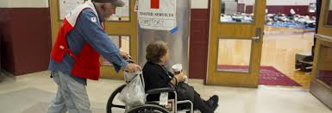
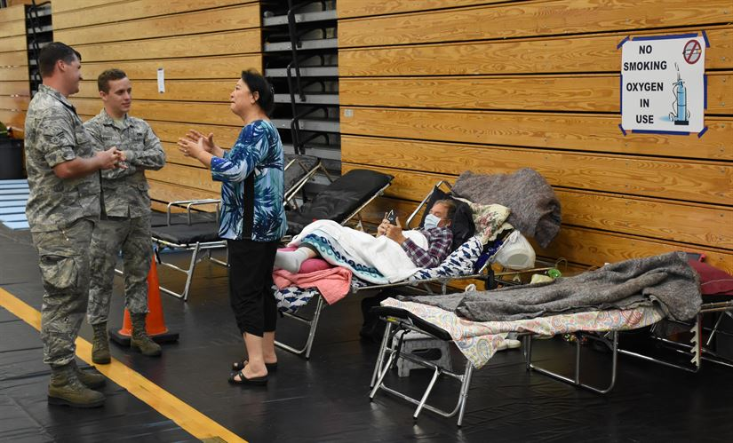
Definition of Access and Functional Needs (AFN)
CMIST* - focus on functional needs; not diagnosis or demographic
*CMIST model developed 2012 by June Isaacson Kailes, Disability Policy Consultant
C
Communication
M
Maintaining Health
I
Independence
S
Supervision
T
Transportation

Slide 7
AFN Population includes…
People with disabilities
People who are older adults
People with chronic conditions or injuries
People who live in institutional settings
People from diverse cultures
People with limited English proficiency
Persons who are transportation disadvantaged
Persons who are low income or homeless
Women who are pregnant
Whole Community Approach

Slide 8
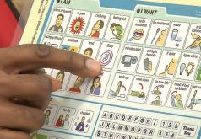
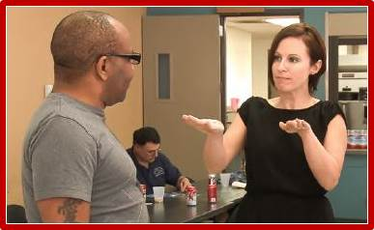
Communications
Areas impacted include:
Planning – all phases
Communications
Notifications
Evacuation
Shelter
Recovery

Slide 9
Communications
Impacts all phases – before, during, and after
ASL interpreters at press conferences, public meetings, etc.
Meeting notice – large font, ADA statement
Accessible signage
Alternate formats available upon request
Interpreters available upon request
Messaging is simple and easy to read – plain language
https://www.plainlanguage.gov/

Slide 10
Notifications
Must be designed to reach all
Persons with limited English proficiency
Persons who are Deaf and hard of hearing
Persons who are blind or have vision loss
Persons with a mobility loss
Public Warning Systems
Reverse 911
Television
Radio
Integrated Public Alert and Warning System (IPAWS)

Slide 11
Evacuation
Must be designed to reach all
Persons with mobility loss
Persons with dementia, Alzheimer’s, memory loss
Persons with developmental disabilities
Persons with limited English
Persons living in institutional settings
Others with access and functional needs

Slide 12
Recovery
Accessible Meeting Checklist
Physical and programmatic access
Notices accessible
Websites and other forms of communication
Alternate formats available
Sign language interpreters

Slide 13
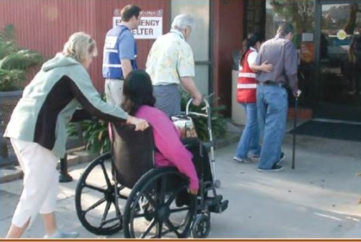
Supporting Persons with Access and Functional Needs
Be respectful!
Ask, ask, ask!
Keep it simple!
Avoid shouting.
Avoid assumptions.
Keep people informed.
Respectful communication.
Ask for help!
Disability Sensitivity Video

Slide 14
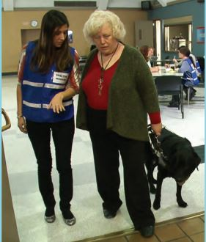
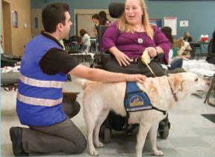
Supporting persons who use assistance or service animals
Types of service animals:
Guide dog  Service dog
Hearing dog  Miniature pony
General Guidelines:
Working – not a pet
Trained to perform tasks
On-duty at all times
Do not pet or distract
Do not offer treats or food
Residents with allergies or phobia

Slide 15
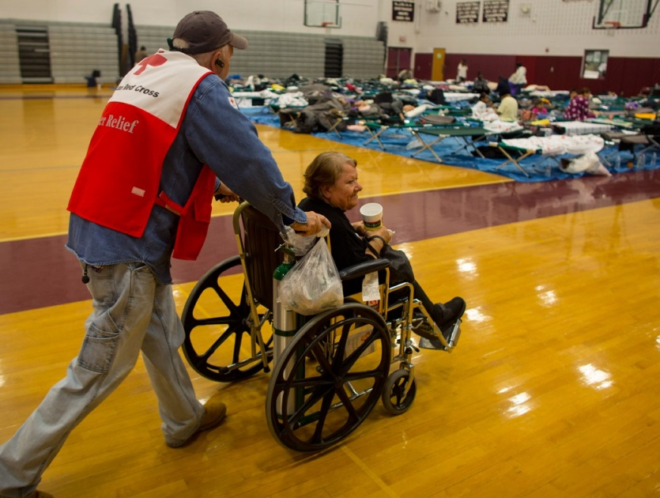
Supporting persons who use wheelchairs or have mobility loss
Always ask before helping
Wheelchair, walker, assistive devices – personal space
Kneel down or get a chair for extended conversation
Caregiver assistance
Durable medical equipment (DME)
Consumable medical supplies (CME)
Prescriptions

Slide 16
Supporting persons who are Deaf or hard-of-hearing
Getting attention – wave hand or gently tap shoulder
Communication (lip reading, write notes, or sign language)
Ask about comfort with writing notes
ASL interpreter requested
Resident with sign language skills
Speak directly to the person
When speaking – face in full view – avoid bright light
Speak clearly ̶ use your normal voice
Keep it simple and short – repeat to confirm understanding

Slide 17
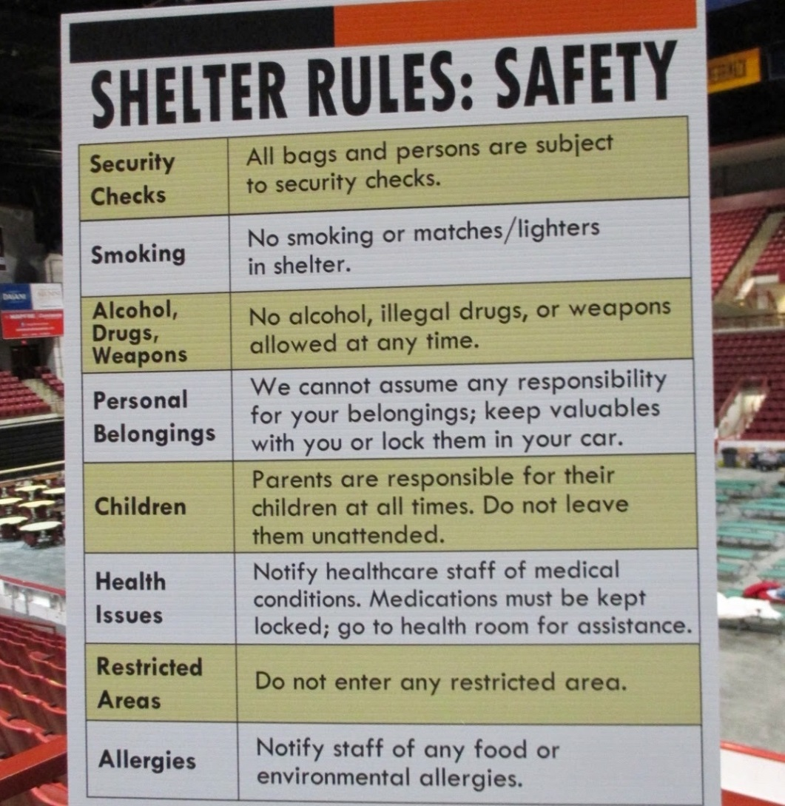
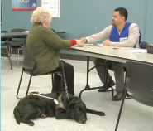
Supporting person who are blind or have low vision
Identify yourself when meeting
Address the person by their name
Excuse yourself when leaving
Offer to orient the person
Offer your elbow
Do not assume complete vision loss
Identify obstacles – move them if permissible
Be specific. Avoid “over there”. Instead, “20 feet to your…”
Offer to read written information and signs

Slide 18
Supporting persons who have cognitive or developmental disability
Keep it short, simple, and brief
Condense into steps if needed
Use pictures or objects to illustrate
Present at slow pace
Repeat to confirm understanding
Be patient – let them finish speaking
Calm anxiety and fear – offer a tour or quiet area
Update, reassure, encourage

Slide 20
NYC Shelter Worker Training
NYC Shelter Worker Training

