Slide 1
NapaValleyCOAD.org

Slide 2
Napa Valley COAD General Meeting
July 15, 2025 at 9:00 AM
Crosswalk Community Church
2590 First Street, Napa, CA 94558

Slide 3
Agenda
Welcome
Introductions & General Announcements
COAD Public Facing Trainings
Community Connections
Preparedness Month 2025
COAD Subcommittees
Adjournment | Next General Meeting October 16, 2025 at 1:00PM TBD
NapaValleyCOAD.org

Slide 4
Welcome
Introductions and General Announcements

Slide 5
COAD Public Facing Trainings
Until Help Arrives
Train-the-Trainer – August 12 & 14, 2025 from 8 to 12PM
Training for Trainers – September 25, 2025 TBD
Preparados – UASI McPherson Project Update
One-day Community Emergency Response Training Lite training

Slide 6
Community Connections
Why Napa Valley COAD?

Slide 7
COAD’s ‘Community Connections’ Progress Report
COAD General Meeting
July 2025
NapaValleyCOAD.org

Slide 8
Cultivating Connections Overview
Community Health Improvement Plan Anchor: Increase access to information and services by reducing language and cultural barriers.
Cultivating Connections Community Connections
Used Human-Centered Design to develop the program design, over next year will implement and assess its effectiveness using HCD principles
Five design workshops include 45+ community members
Develop and train a cohort of Community Connectors to serve as trusted messengers and resource navigators
Connectors will share lived experience and language with the communities and people they will serve
Notes:
45+ participated in HCD 30% monolingual Spanish
30% bilingual and bicultural
Conducted workshops in Calistoga -2 and Napa- 3

Slide 9

Community Connections – Why is COAD doing this work?
Aligns with COAD’s strategic plan to engage trusted messengers and continue our language access work during all phases of disaster
Trusted messengers are foundations for safe, effective, and equitable disaster response.
People need support to navigate and access safety net systems in non-emergency times so they are familiar and trusted during a disaster
Notes:
Ties into COAD’s strategic initiatives and goals to engage more trusted messengers with shared lived experience and implement an effective language access model.
We are on track with the project to date.

Slide 10
Community Connections – Three-Year Plan
Phases | Key Activities | Deliverables
Design – July 2025 | Complete emergency messaging focus groups and prepare a written report Conduct design sprints to define the role, training needs, role of hubs, and implementation outreach and communications | Reports covering the outcomes of focus groups and sprints 6 design sprints in total
Recruit & Train – Aug-Dec 2025 | Recruit and train Community Connectors Establish relationships with potential cultural Hubs | 3-4 Connectors hired and trained 2-4 larger hubs identified for larger events
Implement Sept 2025 | Develop and implement multi-media communications campaign Hold community launch events to promote the program to achieve goals for improving access to information and services | Communications campaign launched and community events
Evaluate Jan 2026-June 2027 | Assess and iterate based on ongoing feedback from users and liaisons Develop a funding and structural model for longer-term sustainability | Evaluation results and feedback system in place; Future model
Notes:
Ties into COAD’s strategic initiatives and goals to engage more trusted messengers with shared lived experience and implement an effective language access model.
We are on track with the project to date.

Slide 11

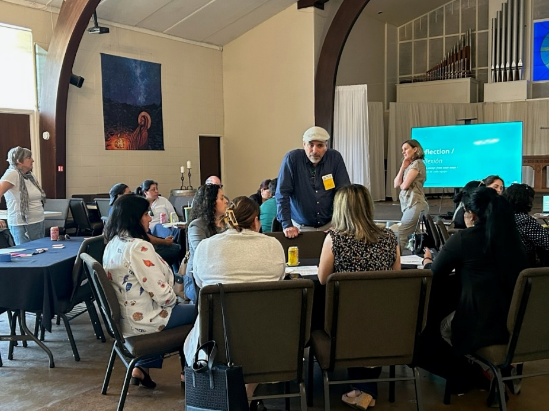
WHAT HAVE WE LEARNED WORKSHOP INSIGHTS
The need for connection is strong across all generational groups
Trauma and anxiety from COVID-19 and the current policy environment is pervasive
We need to include more men in the process and create welcoming spaces for isolated young men
A RESOURCE GUIDE will be essential for Connectors to work effectively. COAD is developing a guide and asset mapping
Community Connectors will need multi-layered support systems and adequate compensation.

Slide 12
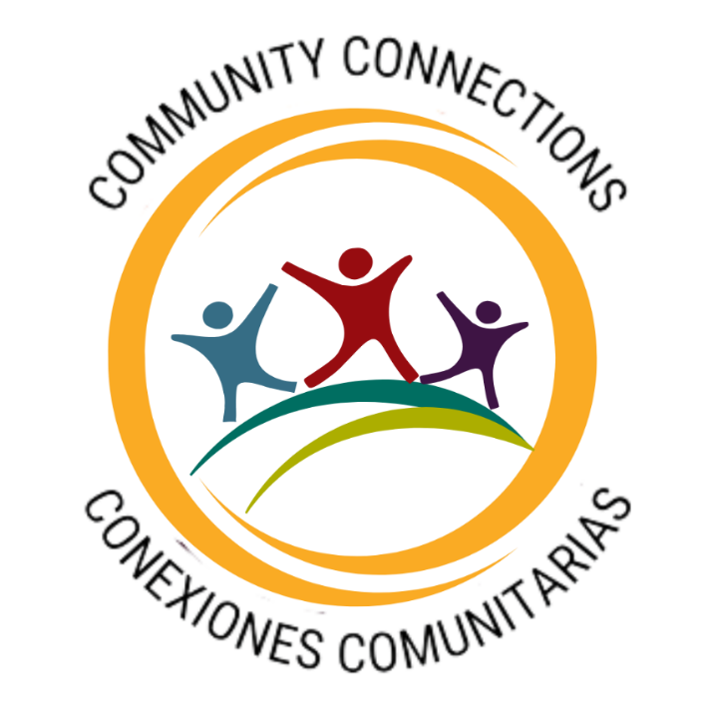
Community Connections – Goals and branding
GOALS articulated at our first workshop:
Conectar la comunidad a recursos crear comunidad (Connect the community to resources to create community).
Support community healing and capacity building through human connection to reduce barriers to access to resources and civic engagement.

Slide 13
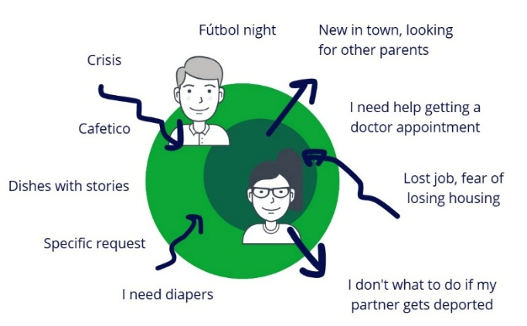
Dual role identified: Individual connections and community engagements

Slide 14
COMMUNITY CONNECTOR CORE ACTIVITIES
RESOURCE NAVIGATORS - WARM HANDOFF
TRUSTED MESSENGERS
COMMUNITY ADVOCATES & VOICES
Notes:
Focus areas – health, mental health, food access and emergency preparedness
Supporting health and well being and safety

Slide 15
COMMUNITY CONNECTOR SKILLS & VIBES
Strong communication and problem-solving skills
Emerging leader
Empathic, open, able to keep confidences, welcoming, reliable
Share lived experience

Slide 16
Core training needs & resources – training must be free and fun!
Core Training Needs | Training Resources
Communication skills/Sensitivity training** | Interpersonal skills trainer
Trauma informed Care** | Aldea
Navigating Health Care & Mental Health Resources ** | LHNC, Public Health, Ole and Providence, Mentis
Resource Guide & Orientation to community and county resources** | COAD + CBO and County Public Health
Civic engagement and rights and responsibilities | CLC and Napa Valley Together
Emergency preparedness | COAD
Food Access | Food Access Coalition
Ongoing support systems – mentors and training | COAD and Partners
Notes:
Training needed to successfully fulfill the role.
Identify free training where available
Check in with OTM’s Parent University on training and recruitment
Be sure to include site visits and connecting Liaisons to people at agencies where they will make referrals.

Slide 17
CONNECTOR$ COMPENSATION PLAN
GENEROUS CAPACITY BUILDING GRANT PROVIDES CAPACITY FOR COAD TO PAY COMMUNITY CONNECTORS
Recruiting 3-4 Connectors in August
Classified as employees – payroll taxes and workers’ comp
Training and work time is compensated
Provide Connectors with a phone stipend, tablet, email address, and reimburse mileage
Create a Connector Google phone line
Notes:
Working out the details

Slide 18
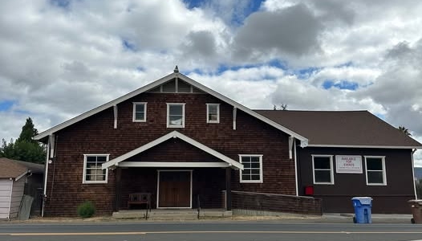
TARGETED LAUNCH: LATE SEPTEMBER AT RUTHERFORD GRANGE
Notes:
“Hubs” are not necessarily permanent sites but adaptable community spaces to engage with community members
Pope Valley Farm Center/Pope Valley Elementary
Angwin volunteer fire department/Howell Mtn School
Berryessa Highlands/Spanish Flats Senior center
Rutherford Grange
American Canyon?
Deer Park?
Brannan Center in Calistoga
North Napa – Unitarian Church?
Soda Canyon?

Slide 19

Developing a comprehensive communications and outreach campaign
How and where do we reach target audiences
What should the core messages be and how to present them
Share results with the Communications Consultant – Lightbox Collaborative

Slide 20
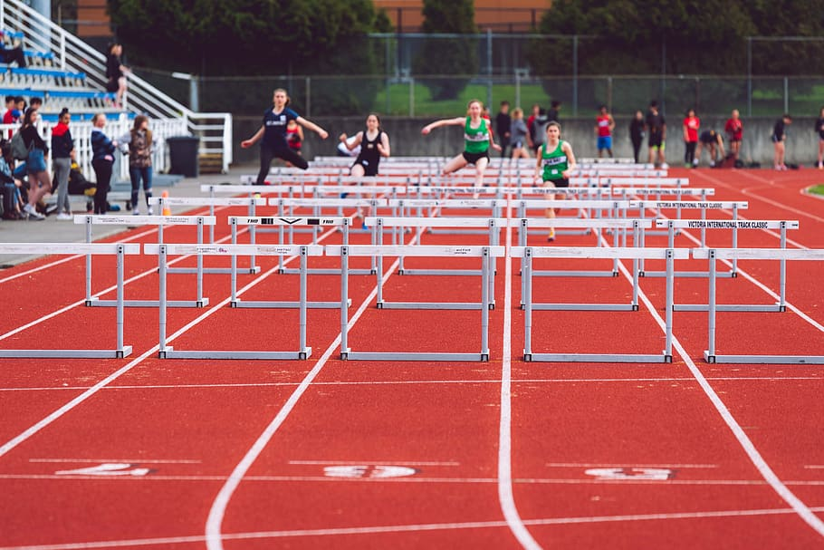
Challenging next steps
Creating an impactful communications and outreach campaign
Recruiting, hiring, and training Community Connectors
Finding mentors for Connectors
Overcoming
Distrust due to negative past experiences and systemic challenges.
Safety concerns exacerbated by current federal policies.
Skepticism around program funding and sustainability.
Collaborating with other trusted messengers to avoid duplication of services.
Developing and implementing program evaluation tools
Ensuring long-term sustainability of Community Connections

Slide 21

Target outcomes – How will success be measured?
Address and improve 50% of the service and emergency communications identified
Increase trusted messengers who are trained to be system navigators in under resourced areas of the county by 50%
Increase COAD outreach efforts by 50% through Connectors
Establish an effective and trusted foundational model for sustainability

Slide 22
National Preparedness Month
Fundraising month for COAD

Slide 23
Napa Valley COAD Committee Updates
Next Napa Valley COAD Board of Directors Meeting
September 18, 2025 at 9:00 AM TBD

