Slide 1
NapaValleyCOAD.org

Slide 2
Napa Valley COAD
General Meeting
March 19, 2026 at 9:00 AM

Slide 3
Agenda
Welcome
DSLC Service
211 Service
COAD Updates
Community Connections Updates
COAD Committees Updates
Member Announcements
Adjournment | Next General Meeting April 28, 2026 at TBD
NapaValleyCOAD.org

Slide 4
Welcome
Introductions and General Announcements

Slide 5
Disability Services & Legal Center
Population Served
General Services and How to Access them
Preparedness and Emergency Services

Slide 6
Disability Services & legal Center
Advancing the rights of people with disabilities to equal justice, access, opportunity, and participation in our communities.

Slide 7

About us:
DSLC has been helping individuals with disabilities and their families in Sonoma County since 1976. Since then, services and resources have been expanded to serve consumers in Lake, Mendocino, & Napa counties as well.
DSLC is 501(C)(3) non-profit organization and is part of California’s Independent Living Center Community.
DSLC is one of California's 28 Centers for Independent Living (CIL/ILC) that promotes the Independent Living philosophy through education, community partnerships and advocacy.

Slide 8

AVAILABLE Services and Projects
Benefits Counseling
Disaster/Emergency Preparedness
HAM (Home Access Modification)/AT (Assistive Technology) Program
Housing Services
Legal Assistance
Advocacy
Transition & Diversions

Slide 9

Benefits Counseling
Principal Staff:
Cheryl Fields
Cherylf@mydslc.org
Consumers can approach DSLC’s benefits department with questions and concerns regarding the Social Security system.
DSLC benefits counselors can help an individual sign up for social security, assist them if their benefits have been reduced or stopped, and help with overpayment issues.
Provides referrals and basic information on Unemployment, CalFresh, Special Needs Trusts and more.

Slide 10

Legal assistance
Primary Staff:
Adam Brown & Lisa Trumbly
Our legal team specializes in assisting consumers with Social Security appeals. Once the legal team decides to take the case, they see it through until the hearing and possibly beyond.
Referrals to Lisa Trumbly gets referred to the Disability Law Clinic (DLC) on a case-by-case basis by DSLC staff
Legal assistance is also available at our branch offices in Napa and Ukiah

Slide 11

DDAR (Disability Disaster Access & Resources)
Principal Staff:
Steven Vera
Steven@mydslc.org
All applicants must be part of PG&E's Medical Baseline Program to qualify
For 2026 – Greater focus on Disaster Preparedness & Education (i.e to-go bags, Plan of Action during a disaster)
Referral for back-up batteries
Notes:
To qualify for Back-Up Battery:
Must be Dependent on a Medical Device
Live in a Tier 1 or Tier 2 High-Fire Area
Must be signed on to the PG&E Medical Baseline Program

Slide 12
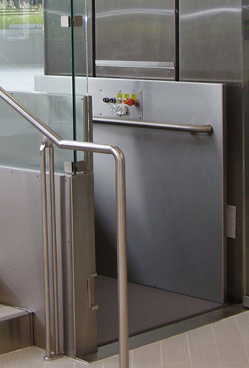
HAM/AT home access Modification & assistive technology
Principal Staff:
Justin Parvin
Justin@mydslc.org
Sonoma County specific program that helps low-income individuals regain mobility and access to their communities by subsidizing costs to install Ramps, Lifts, Grab Bars, and more.
Income Requirements:
1 Person Household: $65,550/yr
2 Person Household: $76,050/yr
Assistive Technology is any adaptive aid used by a person with disabilities to function as independently as possible at home or in the workplace.

Slide 13

Housing Services
Principal Staff:
Miryam Mendoza
Miryam@mydslc.org
Program focus is to provide housing search information, training, and referrals to people with disabilities seeking accessible and affordable housing.
Assistance with reasonable accommodation requests, Season of Sharing applications, help filling out Sonoma County housing applications & assist with tenant/landlord issues.

Slide 14

Systems Change Advocacy
Principal Staff:
Collin Thoma
Cthoma@mydslc.org
The systems change advocate is in charge of educating various city, state and federal officials on how policies and actions will affect and impact individuals with disabilities
Collin is currently the Regional Deputy Director for System Change Advocates in the Bay Area & Northern Ca. Works with other System Change Advocates in the region to advocate on Regional, Statewide, & National issues faced by those with disabilities.
Addresses various systematic issues that individuals with disabilities have and rallies support to advocate and move issues to government

Slide 15
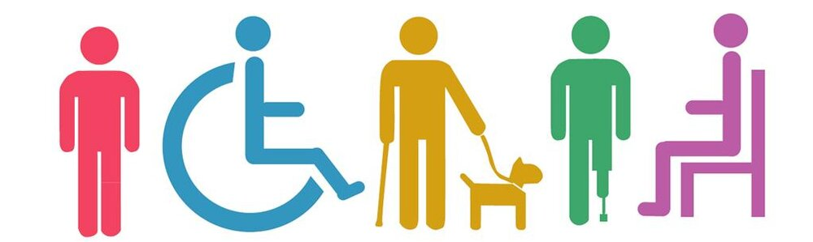
Transitions may be used to assist with a consumer’s transition from a more restricted setting, such as an emergency shelter, temporary housing, or hospitals, into the community setting of their choice.
Youth Transition may be used to transition youth from parent’s home, foster care into a community setting of their own choice
Diversion services are when an individual is at-risk of going into an institutional setting and needs assistance with activities of daily living.
TRANSITIONS &
DIVERSIONS

Slide 16

Aging Disability resource hub (ADRH)
ADRH Liaison:
Kimi Matsuda
KimiMatsuda@mydslc.org
No Wrong Door
3-Tiered Assessment
Warm hand-offs
Enhanced I/A
Options Counseling
Short-Term Service Coordination
Transition Services

Slide 17
CONNECTIONS NAPA COUNTY -
Aging & disability resource connection
Phone: (707) 253-4248 Website: https://ConnectionsNapaCounty.org/
Provides a coordinated network to assist older adults, those with disabilities, & caregivers to navigate the complex system of Support Services
No Wrong Door approach
Information & Assistance (I&A)
Short Term Coordination
Long-term Services & Supports
Transition Assistance

Slide 18
Administrative Leadership
Veronica Castro
Finance Director
VCastro@mydslc.org
Jordan Rico
Program Director
RicoJ@mydslc.org
Adam Brown
Executive Director
AsBrown@mydslc.org

Slide 19

HOW TO ACCESS SERVICES
Main Santa Rosa Office:
418 B Street 3rd Floor
Santa Rosa, CA 95401
(707) 528-2745
M-F: 8:30 A.M. to 5 P.M.
Napa Office:
1820 Jefferson Street
(707) 258-0270
Napa, CA 94559
M-F: 8:30 A.M. to 5 P.M. –
Napa Staff: Victor Hurtado (707) 258-0272
Patricia Sullivan (707) 258-0276
Ukiah Office:
415 Talmage Rd. Ste. B
Ukiah, CA 95482
(707) 463-8875
M-F : 8:00A.M. to 4P.M.

Slide 20
211
United Way
Population Served and Programs Offered
General Connections and Who can Access them
Emergency Services steps to Preparedness, yourself and patrons

Slide 21



United Way Bay Area / 211 Bay Area
March 19, 2026

Slide 22

What is the United Way?
United Way Worldwide (UWW) is the leader of the global United Way network
1,800 United Ways across the world working on:
improving education and youth opportunities
strengthening financial stability
making communities healthier
building community resiliency

Slide 23
United Way Bay Area
VISION
United Way Bay Area envisions an equitable Bay Area where all people have the opportunities and resources needed to thrive.
MISSION
United Way Bay Area mobilizes the Bay Area to dismantle the root causes of poverty and build equitable pathways to prosperity. Through initiatives and policy change, we provide immediate and long-term support for employment, housing, financial stability, and meeting basic needs.

Slide 24
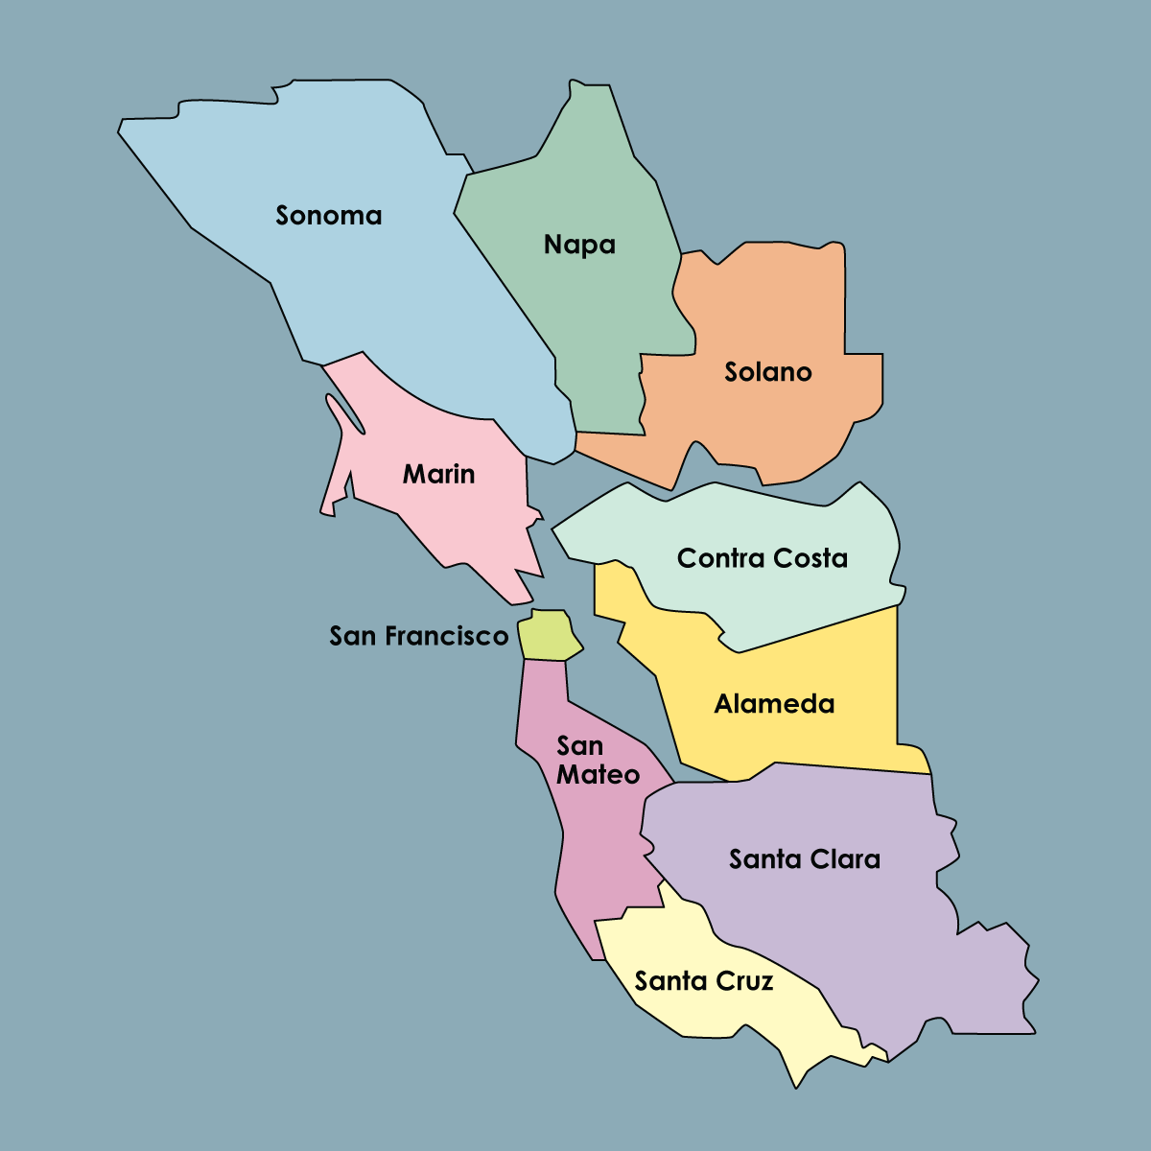
United Way Bay Area
Our service area is 8 counties of the Bay Area – Alameda, Contra Costa, Marin, Napa, San Francisco, San Mateo, Santa Clara, and Solano
These counties have changed over the years.
  In the early 2000s, we added Napa and Solano counties
  In 2016 we merged with the United Way Silicon Valley and added Santa Clara County
Nope!
Not Us!

Slide 25






Areas of Impact
Basic Needs
Employment & Career Opportunities
Financial Stability
Housing Justice
Ensuring people have access to Basic Needs services and resources such as food, shelter, healthcare, and more
Building systems and pathways for youth and adults to achieve their career goals and earn a living wage
Supporting families and individuals to achieve their financial goals, recover from a financial crisis, and have a quality life.
Working with community stakeholders and housing experts to improve access to stable, affordable housing and homelessness prevention.

Slide 26
Our Programs & Initiatives
Basic Needs | Career & Employment Opportunities | Financial Stability | Disaster Response & Special Initiatives
Emergency Food & Shelter (EFSP) | Youth Workforce | Free Tax Help (FTH) | Wildfire Relief + Recovery
Emergency Assistance Network (EAN) | Labor Community Services | SparkPoint | Earthquake Preparedness
211 |  |  | COVID Relief + Rental Relief
 |  |  | Census 2020
<<< Public Policy and Advocacy >>>
<<< Housing Justice >>>
<<< Data and Evaluation >>>
<<< Ambassadors Council >>>

Slide 27


Free Tax Help

Slide 28




What is 211?
A free service that connects people and service providers to resources in their area
Confidential
Multilingual (240 languages)
Available 24/7/365

Slide 29
How does it work?
By Call
Call Specialists refer callers to services
Often, a caller will have multiple needs and will be given referrals to several services
By Web
Search the programs and services in the 211 database
Organized by category to help the user find what they need
By Text
Users can text their zip code to 898211 and a live specialist will respond
Users can text keywords (e.g. Benefits, Taxes, Stress) to 211-211 and receive information and referrals or participate in screenings

Slide 30
A Quick History of 211
United Way of Atlanta began offering 211 services in 1997
United Way Worldwide and AIRS (Alliance of Information and Referral Systems) began to help with implementation across the country
The FCC designated the 3-digit code in July of 2000
The California Public Utilities Commission designates 211 by county

Slide 31
Quick History of 211 in the Bay Area
UWBA started operating the Helpline in 1977
Transitioned to 211 in 2004 with the first CPUC designation in San Francisco
Since 2004, we've responded to over 900,000 calls/texts and referred to over 2 million services and programs
Notes:
Skip to slide 8

Slide 32
Why 211 and United Way?
United Ways have a rich history of operating helplines, serving as a hub for community services information
211 allows United Ways to better understand community needs and respond appropriately
211 is also a strategic outreach vehicle for many of the financial, educational, and health-related programs of United Ways and their partners
United Ways play a critical role in disaster relief, which includes relief funds, emergency services, and 211

Slide 33



Where is 211 available?
In the Bay Area: www.211bayarea.org,
www.edenir.org, www.crisis-center.org, www.211sonoma.org/
In California: https://www.211ca.org/about-2-1-1
Worldwide: https://www.211.org/about-us/your-local-211
Notes:
211's manage local websites

Slide 34
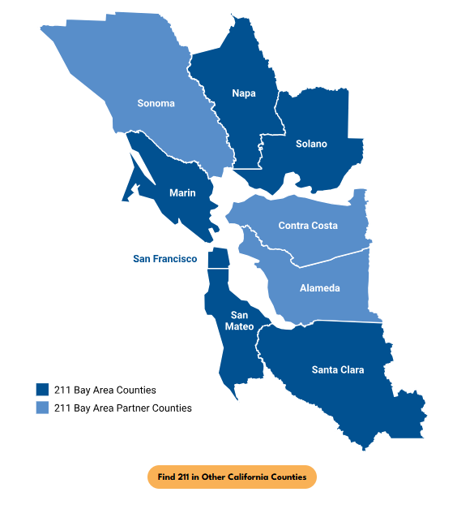
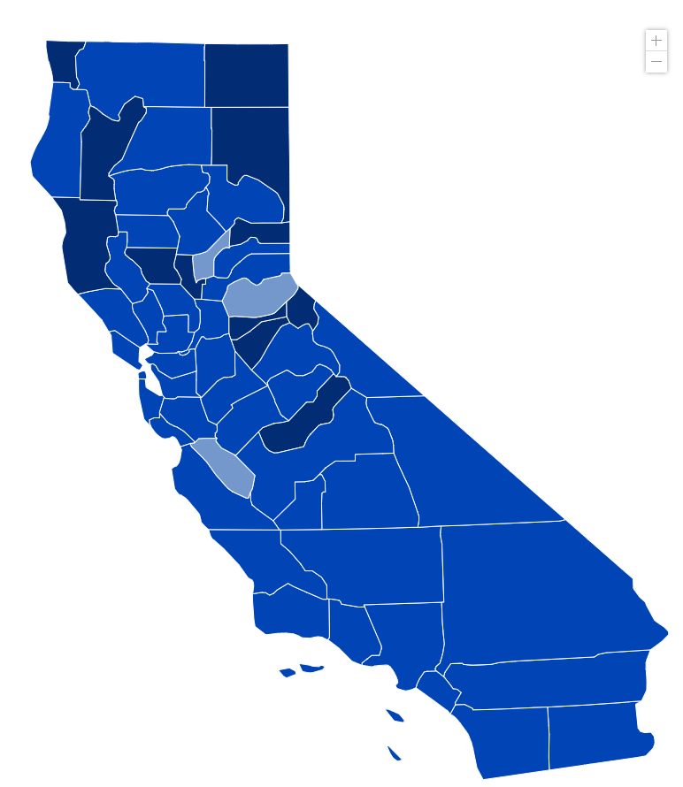
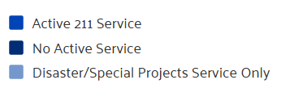
Where is 211 available?
Notes:
I am part of each VOAD and COAD in the 6 counties that 211 covers, as well as NorCal VOAD

Slide 35
Why/How 211 in an Emergency
Easily Accessible 24/7/365
Right/best information because of partnerships & years of service
Extensive Database
Help alleviate the # of non-emergency calls made to 911
Collect information about callers and community needs
Identify service gaps that exist or emerge
Notes:
I am part of each VOAD and COAD in the 6 counties that 211 covers, as well as NorCal VOAD

Slide 36
211 Roles Emergency Response
An important conduit of public information, working with local officials and various response agencies.
Resources for food, water, and other
basic needs
Evacuation Routes
Public Health Support: E.g. mask mandates, vaccine appointments
Crisis Hotlines
Emergency Shelters
Donations and Volunteering
Emergency Status
Long term recovery
211 211 Keyword push texting campaigns
Reduce call volume to 911
Notes:
News items/211now.com
Why it's important for 211 to be involved
In San Mateo County - Motel Voucher program – we were able to change how we make referrals during the storm event, and then go back to normal
unincorporated callers reporting downed trees or other infrastructure problems are being directed to County Public Works: 650-363-4100.
For housed individuals that need shelter and don't have another place to go, we are referring them to one of two places depending on their location. For callers on the Bayside, operators should tell them to go directly to the Red Cross Shelter located at the San Mateo County Event Center (1346 Saratoga Dr, San Mateo, CA). For callers on the Coastside, operators should do a warm transfer to 650-454-9479 for an intake screening (but that number should not be shared with the public).
For unhoused callers, we are directing them to the core service agencies. The Inclement Weather Program is still in place and extra shelter beds are available. However, it's important to know that no one would be turned away from a Red Cross shelter.
Beyond 10pm tonight, please tell any housed people needing shelter on the Coastside to go to the Red Cross shelter in San Mateo (address in the Bayside script). Please let me know if you have any questions.

Slide 37



211 Bay Area Projects
Emergency Preparedness Screening & Care Coordination (Statewide)
Airbnb.Org Emergency Response
Lyft – Ride United Program (Wherever Lyft is)
Earthquake Preparedness (Statewide)
Tobacco Cessation (Statewide)
Caregiver Support Program (our six counties)
California vs Hate (Statewide)
Data Exchange Framework (Statewide)
Notes:
To ensure that the UNITED WE FIGHT. UNITED WE WIN. Artwork is on top of the photo you may have to click on photo box and select to SEND TO BACK.

Slide 38

Emergency Preparedness Screening & Care Coordination
PG&E Partnership with 211 California Provider Network (CAPN)
https://www.youtube.com/watch?v=-3X0tyUXKnk
Special Focus on population with Access and Functional Needs (AFN)
Care Coordination for all households that opt in
Notes:
211 Conducts Proactive Outreach and Screenings to identify California AFN households, and how to best support them during power shutoffs.
211 has engaged with Salvation Army to identify opportunities for coordination around booking hotel rooms for callers during PSPS events.

Slide 39



Airbnb.org Partnership
Partnership with Airbnb.org and 211 Bay Area
Activated during Napa Pickett Fire, but didn't provide housing
Activated two weeks ago for 2 apartment complex fires in Santa Clara County

Slide 40

Ride United – Lyft Partnership
Provides up to 4 free, Lyft rides to individuals:
  Medical/Healthcare. Ex: Medical appointments, Urgent Care (non-emergency)
  Financial Assistance (including public benefits, CalWORKs, SNAP, WIC, General Relief, and housing vouchers)
  Disaster (transportation to shelter, hotel, relocation site, or to return home, and more)
  Legal aid
  Job/Career Center (not to a job interview. not to get to and from job)
  Food Pantries

Slide 41
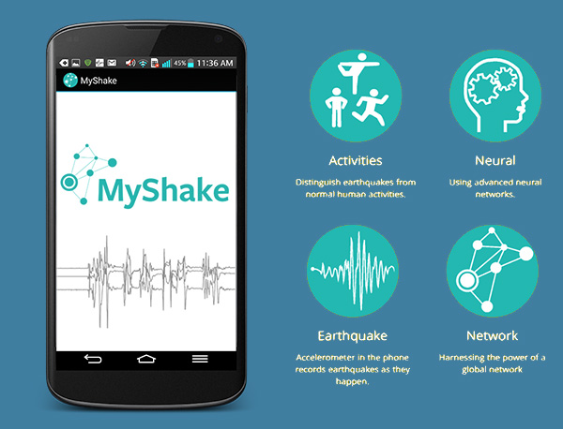
Earthquake Preparedness
Partnership with CalOES and UC Berkeley
Promoting Earthquake Early Warning System via MyShake App: https://myshake.berkeley.edu/
Text Earthquake or Terremoto to 211-211

Slide 42


Tobacco Cessation (Statewide)
Partnership with Kick It California to help residents stop using tobacco products

Slide 43

Caregiver Support Program
If you’re caring for someone and struggling to find support, AARP and United Way Bay Area have teamed up to help you get local resources and AARP family caregiving resources through 211.
Text Caregiver to 211211​
Text Cuidador to 211211​
Call 211​
Learn more here​
https://unitedwaysca.org/caregivers/

Slide 44

California VS Hate
Non-emergency hate incident and hate crime reporting system
Call specialist will assess the caller’s safety, determine the need for emergency assistance, and provide connections to local resources for physical and mental health support.

Slide 45

Data Exchange Framework (DxF)
Statewide data sharing agreement aimed at achieving the state’s plans for improving connections between health and social services entities.
By February 2026, be able to share 211 data in real-time with external agencies
Participating in partnership with UWCA & 8 other 211s/UWs

Slide 46
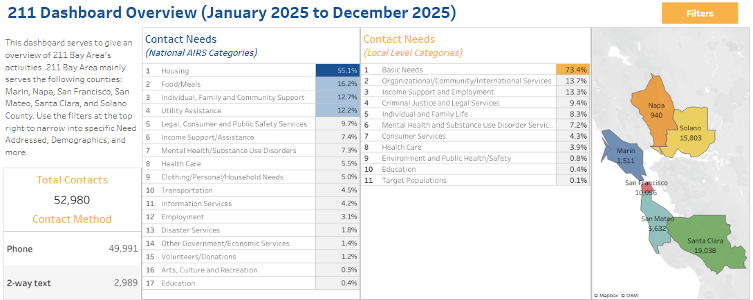
211 Data Dashboards
Access here:
https://uwba.org/what-we-do/211-bay-area/
https://211bayarea.org/about-211-bay-area/reports-dashboards/
Filter by geography, demographics and more!

Slide 47
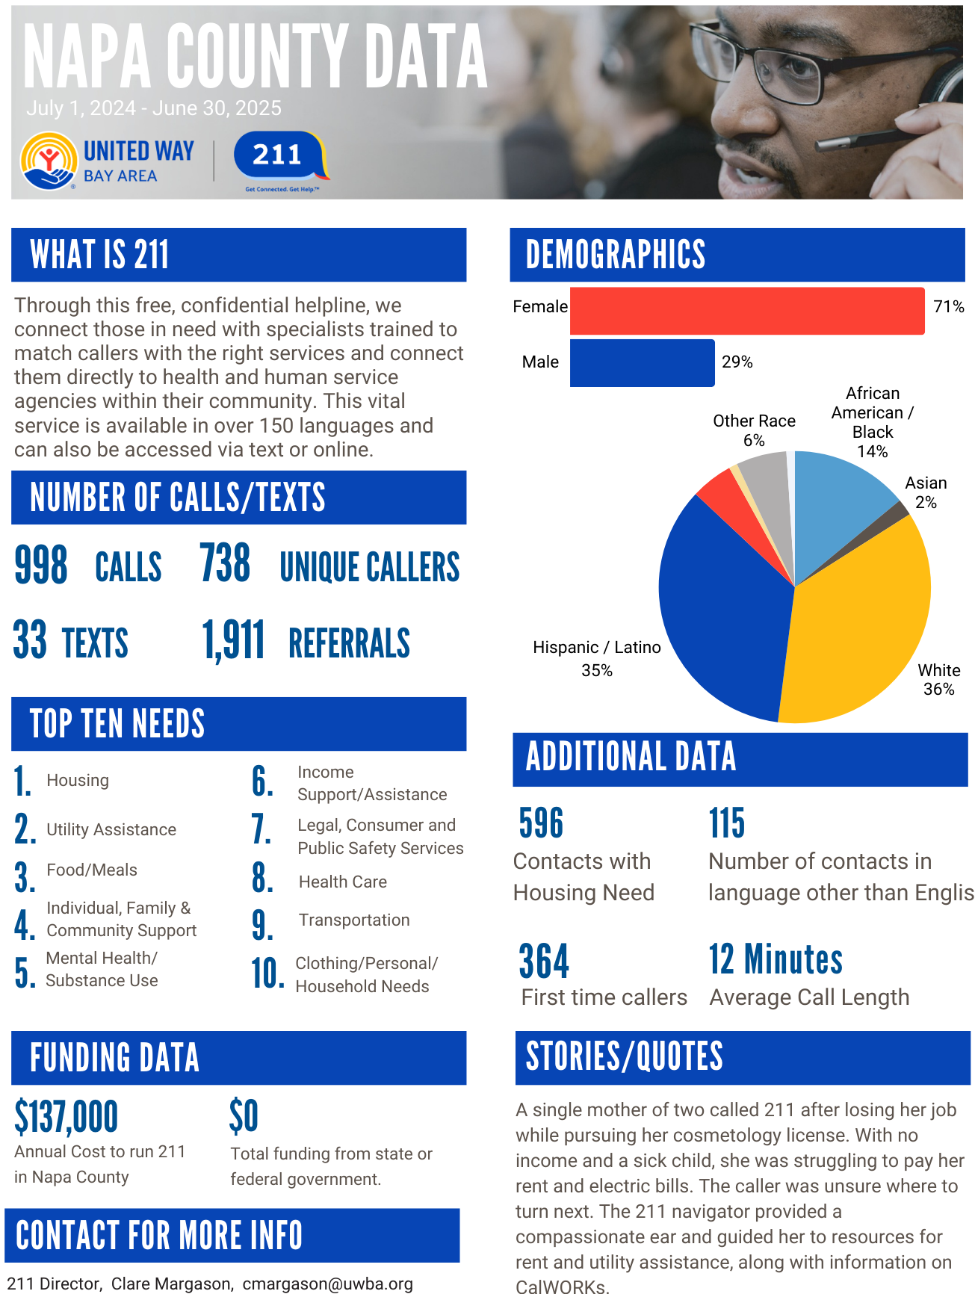
Napa County FY25 Stats
Notes:
43 000 * 9 minutes =
268.75 days

Slide 48

211 Capacity Challenges
211 in California has never received federal or state funding
Each local 211 fundraises independently (some are more successful than others)
State budget request
  Budget Letter
  Sign on here

Slide 49
211 Resources
211 Data Dashboard
For Agencies interested in being added to the 2-1-1 Database:
https://www.211bayarea.org/apply-join-database/
To make an update or ADD NEW information to an existing organization in the 2-1-1 Database:
https://www.211bayarea.org/update/
For assistance with updating your Agency or Program information contact us at 211@uwba.org
Communications Toolkit – Available to all partners
For flyers or cards, email cmargason@uwba.org or mlaureta@uwba.org or or call 415-808-4335

Slide 50

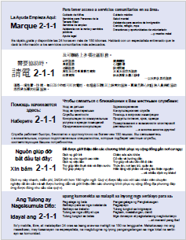

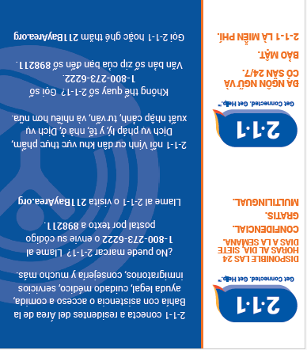
Sample Flyers
Pocket/business cards in four languages (can be folded so preferred language is in the front): English, Spanish, Mandarin and Vietnamese
Full Page Flyer – Front in English, Back in Spanish, Mandarin, Russian, Vietnamese and Tagalog

Slide 51
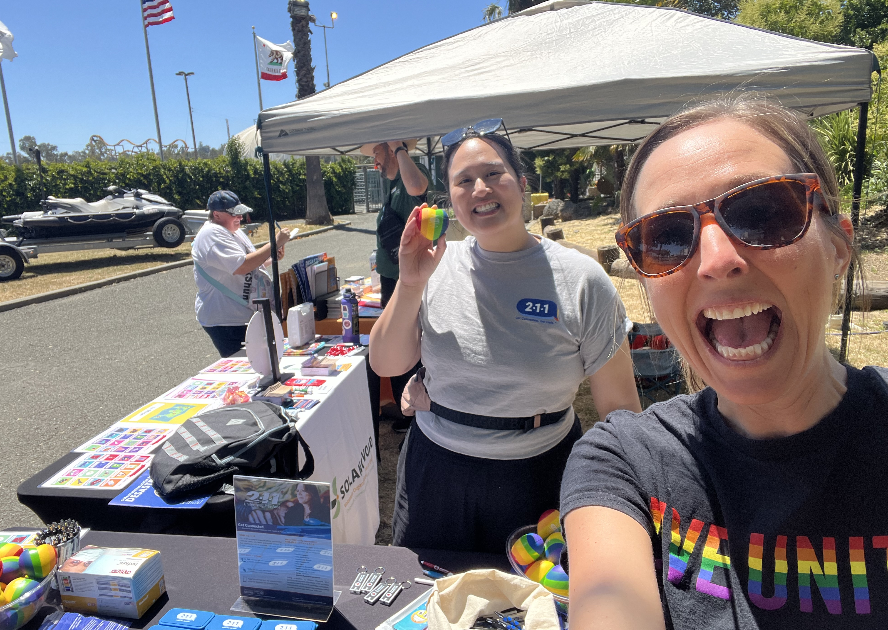
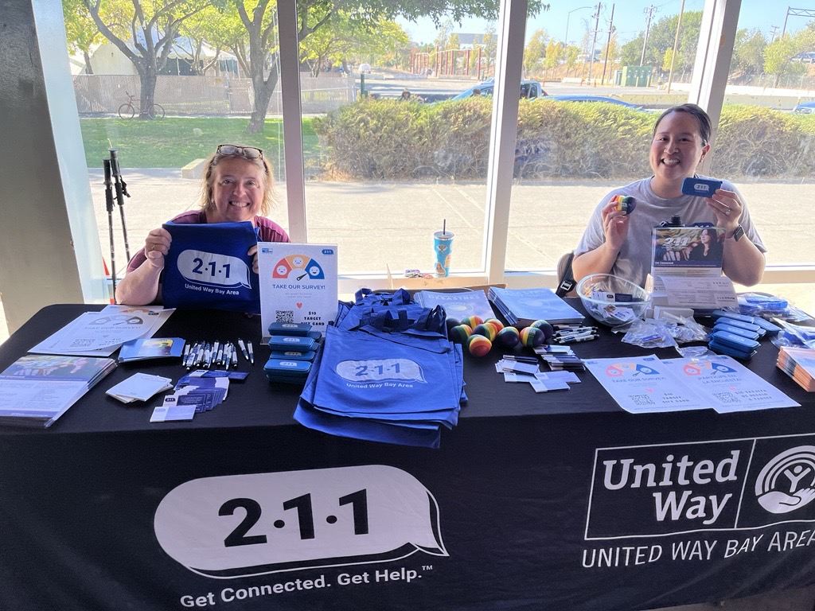
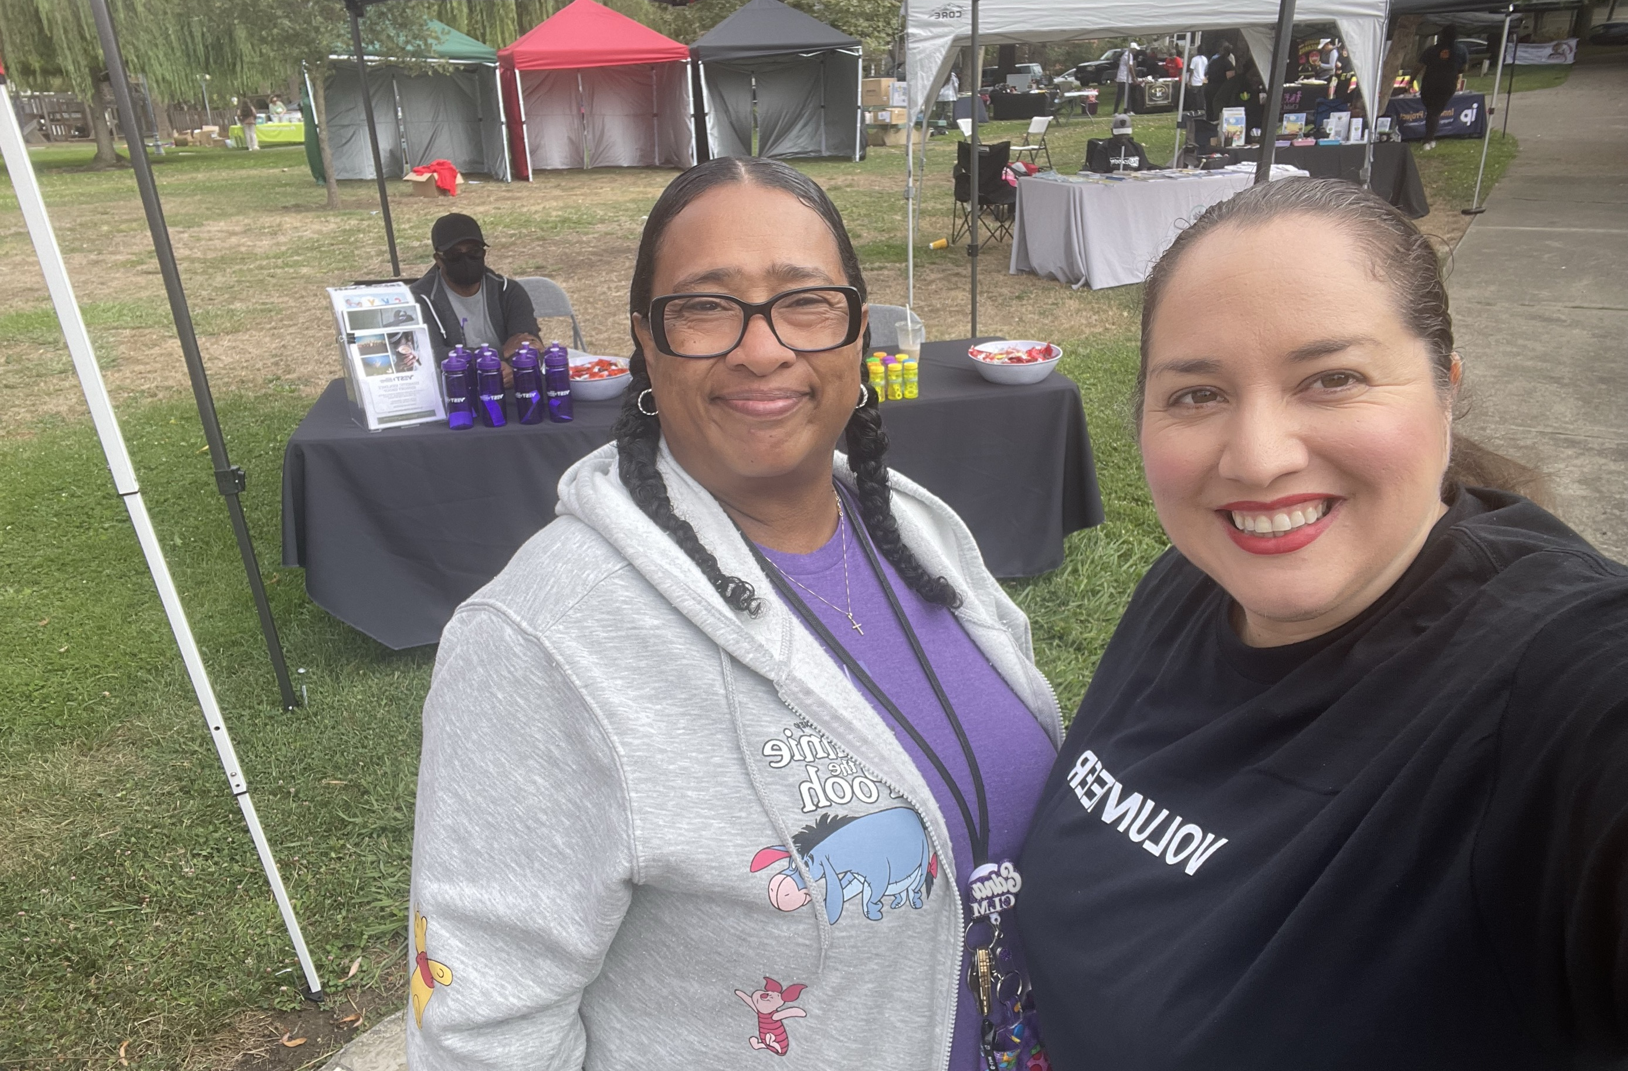
211 Team at UWBA
Clare Margason, cmargason@uwba.org ---Anything 211 Related
Odette Cifuentes-Garcia, ocifuentes-garcia@uwba.org ---211 Resources
Laura Escobar, lescobar@uwba.org ---Strategy, Advocacy, History
Melissa Laureta-Ratto, mlaureta-ratto@uwba.org ---Outreach & Tableau Dashboard
Lily Ana Marquez, lmarquez@uwba.org ---Outreach and Lived Experience Board
Emily Chan, echan@uwba.org ---Data & Evaluation
Notes:
Talk about Call Center 27-40 call specialists supporting us
2-4 resource maintenance staff
UWCA Partnership

Slide 52
Thank you!
Questions?

Slide 53
United Way Bay Area / 211 Bay Area
March 19, 2026

Slide 54
What is the United Way?
United Way Worldwide (UWW) is the leader of the global United Way network
1,800 United Ways across the world working on:
improving education and youth opportunities
strengthening financial stability
making communities healthier
building community resiliency

Slide 55
United Way Bay Area
VISION
United Way Bay Area envisions an equitable Bay Area where all people have the opportunities and resources needed to thrive.
MISSION
United Way Bay Area mobilizes the Bay Area to dismantle the root causes of poverty and build equitable pathways to prosperity. Through initiatives and policy change, we provide immediate and long-term support for employment, housing, financial stability, and meeting basic needs.

Slide 56
United Way Bay Area
Our service area is 8 counties of the Bay Area – Alameda, Contra Costa, Marin, Napa, San Francisco, San Mateo, Santa Clara, and Solano
These counties have changed over the years.
  In the early 2000s, we added Napa and Solano counties
  In 2016 we merged with the United Way Silicon Valley and added Santa Clara County
Nope!
Not Us!

Slide 57
Areas of Impact
Basic Needs
Employment & Career Opportunities
Financial Stability
Housing Justice
Ensuring people have access to Basic Needs services and resources such as food, shelter, healthcare, and more
Building systems and pathways for youth and adults to achieve their career goals and earn a living wage
Supporting families and individuals to achieve their financial goals, recover from a financial crisis, and have a quality life.
Working with community stakeholders and housing experts to improve access to stable, affordable housing and homelessness prevention.

Slide 58
Our Programs & Initiatives
Basic Needs | Career & Employment Opportunities | Financial Stability | Disaster Response & Special Initiatives
Emergency Food & Shelter (EFSP) | Youth Workforce | Free Tax Help (FTH) | Wildfire Relief + Recovery
Emergency Assistance Network (EAN) | Labor Community Services | SparkPoint | Earthquake Preparedness
211 |  |  | COVID Relief + Rental Relief
 |  |  | Census 2020
<<< Public Policy and Advocacy >>>
<<< Housing Justice >>>
<<< Data and Evaluation >>>
<<< Ambassadors Council >>>

Slide 59
Free Tax Help

Slide 60
What is 211?
A free service that connects people and service providers to resources in their area
Confidential
Multilingual (240 languages)
Available 24/7/365

Slide 61
How does it work?
By Call
Call Specialists refer callers to services
Often, a caller will have multiple needs and will be given referrals to several services
By Web
Search the programs and services in the 211 database
Organized by category to help the user find what they need
By Text
Users can text their zip code to 898211 and a live specialist will respond
Users can text keywords (e.g. Benefits, Taxes, Stress) to 211-211 and receive information and referrals or participate in screenings

Slide 62
A Quick History of 211
United Way of Atlanta began offering 211 services in 1997
United Way Worldwide and AIRS (Alliance of Information and Referral Systems) began to help with implementation across the country
The FCC designated the 3-digit code in July of 2000
The California Public Utilities Commission designates 211 by county

Slide 63
Quick History of 211 in the Bay Area
UWBA started operating the Helpline in 1977
Transitioned to 211 in 2004 with the first CPUC designation in San Francisco
Since 2004, we've responded to over 900,000 calls/texts and referred to over 2 million services and programs
Notes:
Skip to slide 8

Slide 64
Why 211 and United Way?
United Ways have a rich history of operating helplines, serving as a hub for community services information
211 allows United Ways to better understand community needs and respond appropriately
211 is also a strategic outreach vehicle for many of the financial, educational, and health-related programs of United Ways and their partners
United Ways play a critical role in disaster relief, which includes relief funds, emergency services, and 211

Slide 65
Where is 211 available?
In the Bay Area: www.211bayarea.org,
www.edenir.org, www.crisis-center.org, www.211sonoma.org/
In California: https://www.211ca.org/about-2-1-1
Worldwide: https://www.211.org/about-us/your-local-211
Notes:
211's manage local websites

Slide 66
Where is 211 available?
Notes:
I am part of each VOAD and COAD in the 6 counties that 211 covers, as well as NorCal VOAD

Slide 67
Why/How 211 in an Emergency
Easily Accessible 24/7/365
Right/best information because of partnerships & years of service
Extensive Database
Help alleviate the # of non-emergency calls made to 911
Collect information about callers and community needs
Identify service gaps that exist or emerge
Notes:
I am part of each VOAD and COAD in the 6 counties that 211 covers, as well as NorCal VOAD

Slide 68
211 Roles Emergency Response
An important conduit of public information, working with local officials and various response agencies.
Resources for food, water, and other
basic needs
Evacuation Routes
Public Health Support: E.g. mask mandates, vaccine appointments
Crisis Hotlines
Emergency Shelters
Donations and Volunteering
Emergency Status
Long term recovery
211 211 Keyword push texting campaigns
Reduce call volume to 911
Notes:
News items/211now.com
Why it's important for 211 to be involved
In San Mateo County - Motel Voucher program – we were able to change how we make referrals during the storm event, and then go back to normal
unincorporated callers reporting downed trees or other infrastructure problems are being directed to County Public Works: 650-363-4100.
For housed individuals that need shelter and don't have another place to go, we are referring them to one of two places depending on their location. For callers on the Bayside, operators should tell them to go directly to the Red Cross Shelter located at the San Mateo County Event Center (1346 Saratoga Dr, San Mateo, CA). For callers on the Coastside, operators should do a warm transfer to 650-454-9479 for an intake screening (but that number should not be shared with the public).
For unhoused callers, we are directing them to the core service agencies. The Inclement Weather Program is still in place and extra shelter beds are available. However, it's important to know that no one would be turned away from a Red Cross shelter.
Beyond 10pm tonight, please tell any housed people needing shelter on the Coastside to go to the Red Cross shelter in San Mateo (address in the Bayside script). Please let me know if you have any questions.

Slide 69
211 Bay Area Projects
Emergency Preparedness Screening & Care Coordination (Statewide)
Airbnb.Org Emergency Response
Lyft – Ride United Program (Wherever Lyft is)
Earthquake Preparedness (Statewide)
Tobacco Cessation (Statewide)
Caregiver Support Program (our six counties)
California vs Hate (Statewide)
Data Exchange Framework (Statewide)
Notes:
To ensure that the UNITED WE FIGHT. UNITED WE WIN. Artwork is on top of the photo you may have to click on photo box and select to SEND TO BACK.

Slide 70
Emergency Preparedness Screening & Care Coordination
PG&E Partnership with 211 California Provider Network (CAPN)
https://www.youtube.com/watch?v=-3X0tyUXKnk
Special Focus on population with Access and Functional Needs (AFN)
Care Coordination for all households that opt in
Notes:
211 Conducts Proactive Outreach and Screenings to identify California AFN households, and how to best support them during power shutoffs.
211 has engaged with Salvation Army to identify opportunities for coordination around booking hotel rooms for callers during PSPS events.

Slide 71
Airbnb.org Partnership
Partnership with Airbnb.org and 211 Bay Area
Activated during Napa Pickett Fire, but didn't provide housing
Activated two weeks ago for 2 apartment complex fires in Santa Clara County

Slide 72
Ride United – Lyft Partnership
Provides up to 4 free, Lyft rides to individuals:
  Medical/Healthcare. Ex: Medical appointments, Urgent Care (non-emergency)
  Financial Assistance (including public benefits, CalWORKs, SNAP, WIC, General Relief, and housing vouchers)
  Disaster (transportation to shelter, hotel, relocation site, or to return home, and more)
  Legal aid
  Job/Career Center (not to a job interview. not to get to and from job)
  Food Pantries

Slide 73
Earthquake Preparedness
Partnership with CalOES and UC Berkeley
Promoting Earthquake Early Warning System via MyShake App: https://myshake.berkeley.edu/
Text Earthquake or Terremoto to 211-211

Slide 74
Tobacco Cessation (Statewide)
Partnership with Kick It California to help residents stop using tobacco products

Slide 75
Caregiver Support Program
If you’re caring for someone and struggling to find support, AARP and United Way Bay Area have teamed up to help you get local resources and AARP family caregiving resources through 211.
Text Caregiver to 211211​
Text Cuidador to 211211​
Call 211​
Learn more here​
https://unitedwaysca.org/caregivers/

Slide 76
California VS Hate
Non-emergency hate incident and hate crime reporting system
Call specialist will assess the caller’s safety, determine the need for emergency assistance, and provide connections to local resources for physical and mental health support.

Slide 77
Data Exchange Framework (DxF)
Statewide data sharing agreement aimed at achieving the state’s plans for improving connections between health and social services entities.
By February 2026, be able to share 211 data in real-time with external agencies
Participating in partnership with UWCA & 8 other 211s/UWs

Slide 78
211 Data Dashboards
Access here:
https://uwba.org/what-we-do/211-bay-area/
https://211bayarea.org/about-211-bay-area/reports-dashboards/
Filter by geography, demographics and more!

Slide 79
Napa County FY25 Stats
Notes:
43 000 * 9 minutes =
268.75 days

Slide 80
211 Capacity Challenges
211 in California has never received federal or state funding
Each local 211 fundraises independently (some are more successful than others)
State budget request
  Budget Letter
  Sign on here

Slide 81
211 Resources
211 Data Dashboard
For Agencies interested in being added to the 2-1-1 Database:
https://www.211bayarea.org/apply-join-database/
To make an update or ADD NEW information to an existing organization in the 2-1-1 Database:
https://www.211bayarea.org/update/
For assistance with updating your Agency or Program information contact us at 211@uwba.org
Communications Toolkit – Available to all partners
For flyers or cards, email cmargason@uwba.org or mlaureta@uwba.org or or call 415-808-4335

Slide 82
Sample Flyers
Pocket/business cards in four languages (can be folded so preferred language is in the front): English, Spanish, Mandarin and Vietnamese
Full Page Flyer – Front in English, Back in Spanish, Mandarin, Russian, Vietnamese and Tagalog

Slide 83
211 Team at UWBA
Clare Margason, cmargason@uwba.org ---Anything 211 Related
Odette Cifuentes-Garcia, ocifuentes-garcia@uwba.org ---211 Resources
Laura Escobar, lescobar@uwba.org ---Strategy, Advocacy, History
Melissa Laureta-Ratto, mlaureta-ratto@uwba.org ---Outreach & Tableau Dashboard
Lily Ana Marquez, lmarquez@uwba.org ---Outreach and Lived Experience Board
Emily Chan, echan@uwba.org ---Data & Evaluation
Notes:
Talk about Call Center 27-40 call specialists supporting us
2-4 resource maintenance staff
UWCA Partnership

Slide 84
Thank you!
Questions?

Slide 85
COAD Updates
Focus for 2026
  Agencies and those you serve
    Staff Workshops and also direct to those you serve
  Continuity of Operations Plan (COOP) / Business Continuity Plan (BCP)
    Review or Implementation
  Communications Planning

Slide 86

Community Connections
Trauma Informed Care Training
Feedback on Connections webpage and any additional needed

Slide 87
Next Co-Chair Meeting: TBD 2026
Access & Functional Needs / Older Adults | Melissa Gerard | Devereaux Smith
Food Access | Cara Mae Wooledge | Wendi Moore
Children & Family Support | Eva Simonsson | OPEN
Emergency Financial Assistance | Lupe Maldonado | OPEN
Communications & Language Access | OPEN | OPEN
Preparedness | Miguel Angel | Peter
Resources | Danielle Barreca | Kara Harrington
Volunteers | Peter | OPEN
Animal Welfare | Wendi Piscia | Saanen Kerson
Shelter Support | Lynn Perez | Dar Valencia
Mental & Spiritual Helath | Kerry Ahearn | Pete Shaw

Slide 88

Community Connections
Updates
NapaValleyCOAD.org/Connections

Slide 89
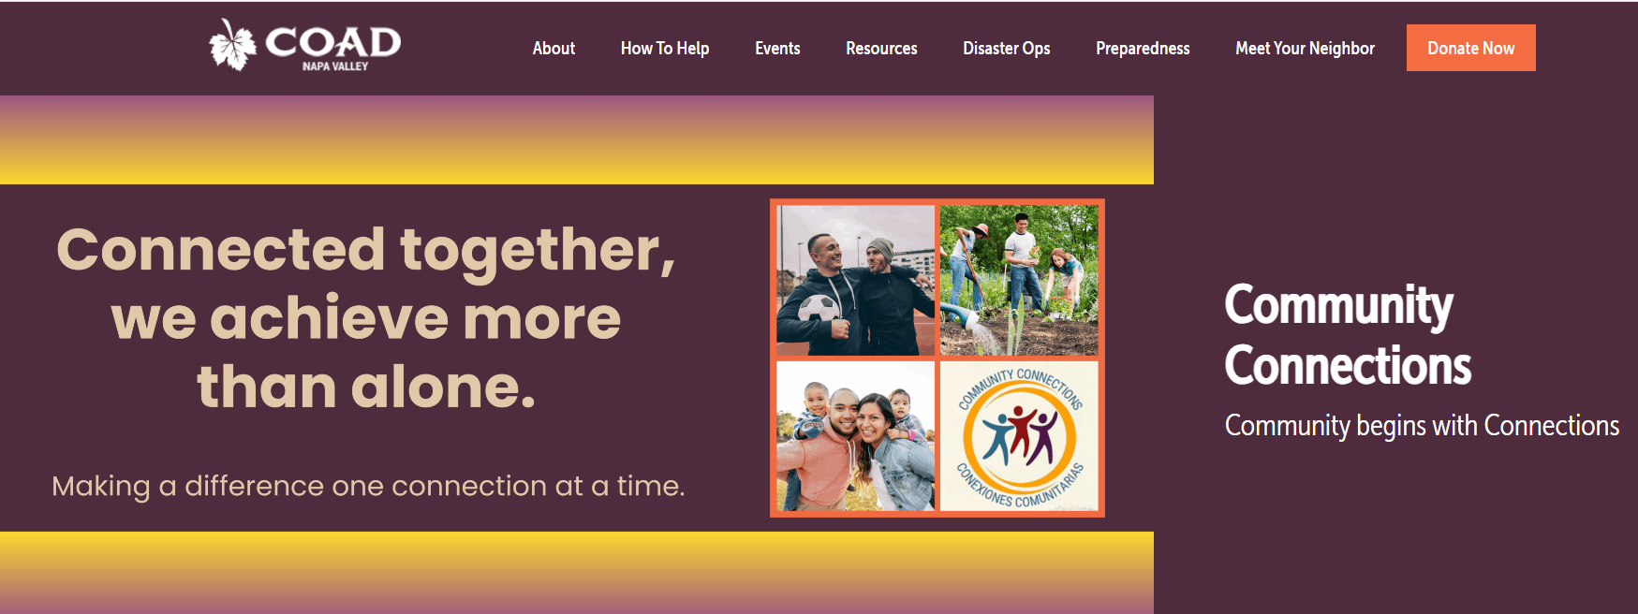
Website
https://napavalleycoad.org/connections
NapaValleyCOAD.org/Connections

Slide 90

Hired Connectors
Recruited Mentors
Claudia - UpValley Family Resource Center
Elia - Napa Junction Family Resource Center
Ligia - Shearer Family Resource Center
Liv – Napa Valley Community Housing
Eduardo - COPE
Susana - UpValley Family Resource Center
NapaValleyCOAD.org/Connections

Slide 91
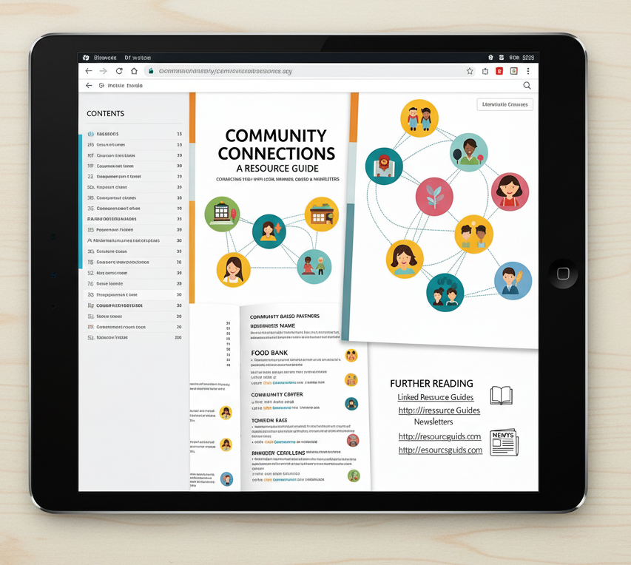
Tablet for Resource Guide
140 Organization Entries
  Organization Duplicates - Service Category
Intake Process
CBO Guides
Newsletter Sign Ups
NapaValleyCOAD.org/Connections

Slide 92
AFN & Older Adults Campaign Update
Informational Campaign (May & June - 4 installments)

Slide 93
Children and Family Services Campaign Update
Informational Campaign (Aug & Sept - 5 installments)

Slide 94
Emergency Financial Assistance and Gift Card Collaborative Update
Gift Card Collaborative (COPE FC, COAD, UVFC, Puertas Abiertas, ParentsCAN, United Way, NVCF)

Slide 95
Food Access Coalition Update
NapaFoodAccess.org

Slide 96
Napa Valley COAD Member Updates
Next Napa Valley COAD General Meeting
April 28, 2026 at TBD

