Slide 1
NapaValleyCOAD.org

Slide 2
Napa Valley COAD
General Meeting
August 18, 2026 at 3:00 PM

Slide 3
Agenda
Welcome
COAD Updates
Community Connections Updates
NEW Intake Process Update
  Fair Housing Advocates of Northern California
Creative Crisis Leadership board game
  Ember Dodge: Neighborhood Evacuation
Adjournment | Next General Meeting October 22, 2026 at TBD
NapaValleyCOAD.org

Slide 4
Welcome
Introductions

Slide 5
COAD Updates
Xochitl López, Bilingual Program Coordinator

Slide 6
Next Co-Chair Meeting:
Access & Functional Needs / Older Adults | Melissa Gerard | Devereaux Smith
Food Access | Cara Mae Wooledge | Wendi Moore
Children & Family Support | Eva Simonsson | OPEN
Emergency Financial Assistance | Lupe Maldonado | OPEN
Communications & Language Access | Celeste Giunta | Gio Miramontes
Mental & Spiritual Health | Kerry Ahearn | Pete Shaw
Preparedness | Xochitl López | Miguel Ángel Castañón
Resources | Danielle Barreca | Kara Harrington
Volunteers | Xochitl López | Katelyn Willoughby
Animal Welfare | Wendi Piscia | Saanen Kerson
Shelter Support | Lynn Perez | Dar Valencia
To find out more or to join a COAD Response Committees please contact Xochitl López at Xochitl@NapaValleyCOAD.org
There have been a lot of changes in our community agencies and we may need your organization represented. We are working on meeting dates now.

Slide 7

Community
Connections
Update
☺
Feedback on Connections webpage and any additional needed

Slide 8

Community Connections UPDATES
NapaValleyCOAD.org

Slide 9
Direct Connections
84 clients
116 sessions
Latino
Asian
White
Housing
Food
Medical
School
Financial

Slide 10

Indirect Engagement
Community pages
Social media
WhatsApp group chats
Family Resource Centers

Slide 11



COAD Workshops led by Connectors
Meet Your Neighbor - 4
Renter’s Insurance - 3
Until Help Arrives - 1

Slide 12
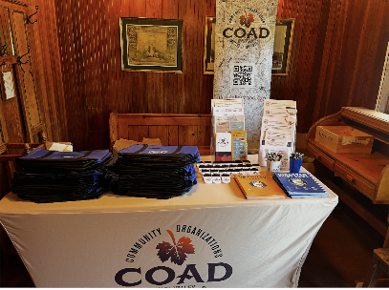
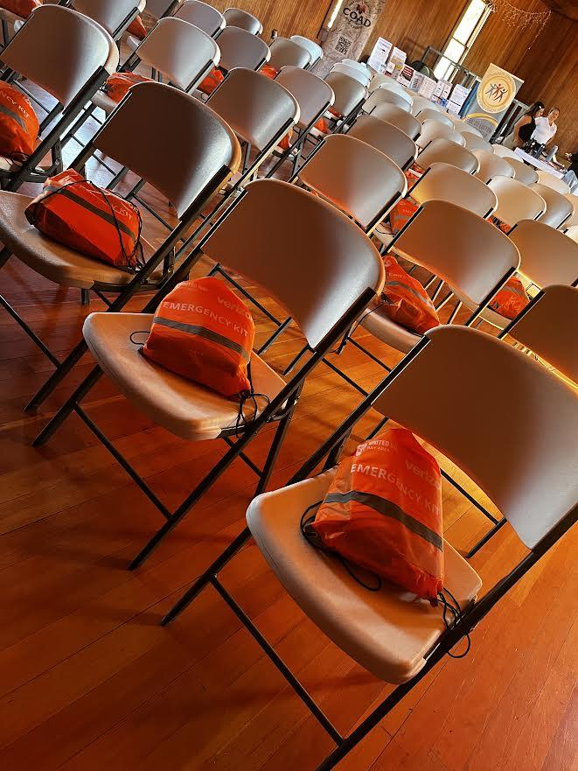
Pope Valley Engagement
Free Food Distribution Tabling
  Insulated grocery bags and resources
  Engage 24 people
Disaster Preparedness Workshop
  COAD/CC
  Napa Valley Together/UVFC
  Engaged 20 people

Slide 13
Lunch & Learns Completed
Spring/Summer
Trauma Informed Care
Napa Valley Transportation Authority
United Way Bay Area 211
Napa Valley Together
MCE
NEWS
More planning for Fall/Winter

Slide 14
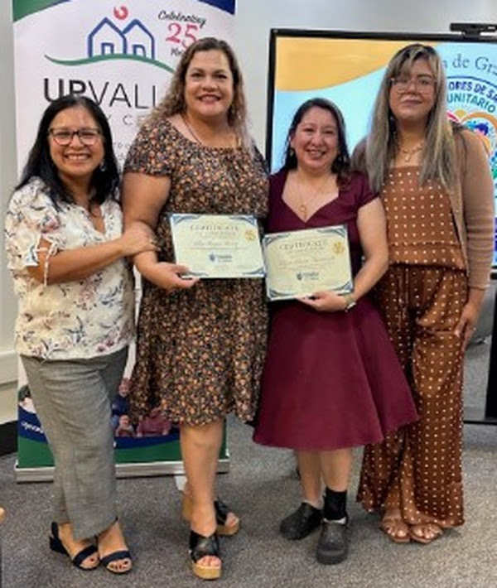
Community Health Worker
Elia and Ligia successfully completed the Touro University California 2026 Community Health Worker (CHW) training with the spring cohort!

Slide 15
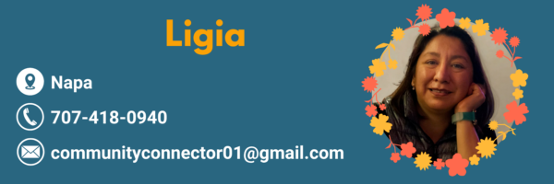
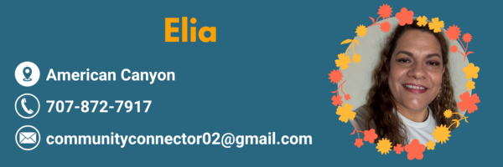


Contact Your Connectors

Slide 16
Fair Housing Advocates of Northern California

Slide 17

Fair Housing Advocates of Northern California
Merger and Services
Presented by:
Jacqueline Saldaña-Pimentel and Maria Callahan

Slide 18
Agenda
FHNV and FHANC Merger
FHANC Services
What is Fair Housing?
FHANC Contact Information

Slide 19
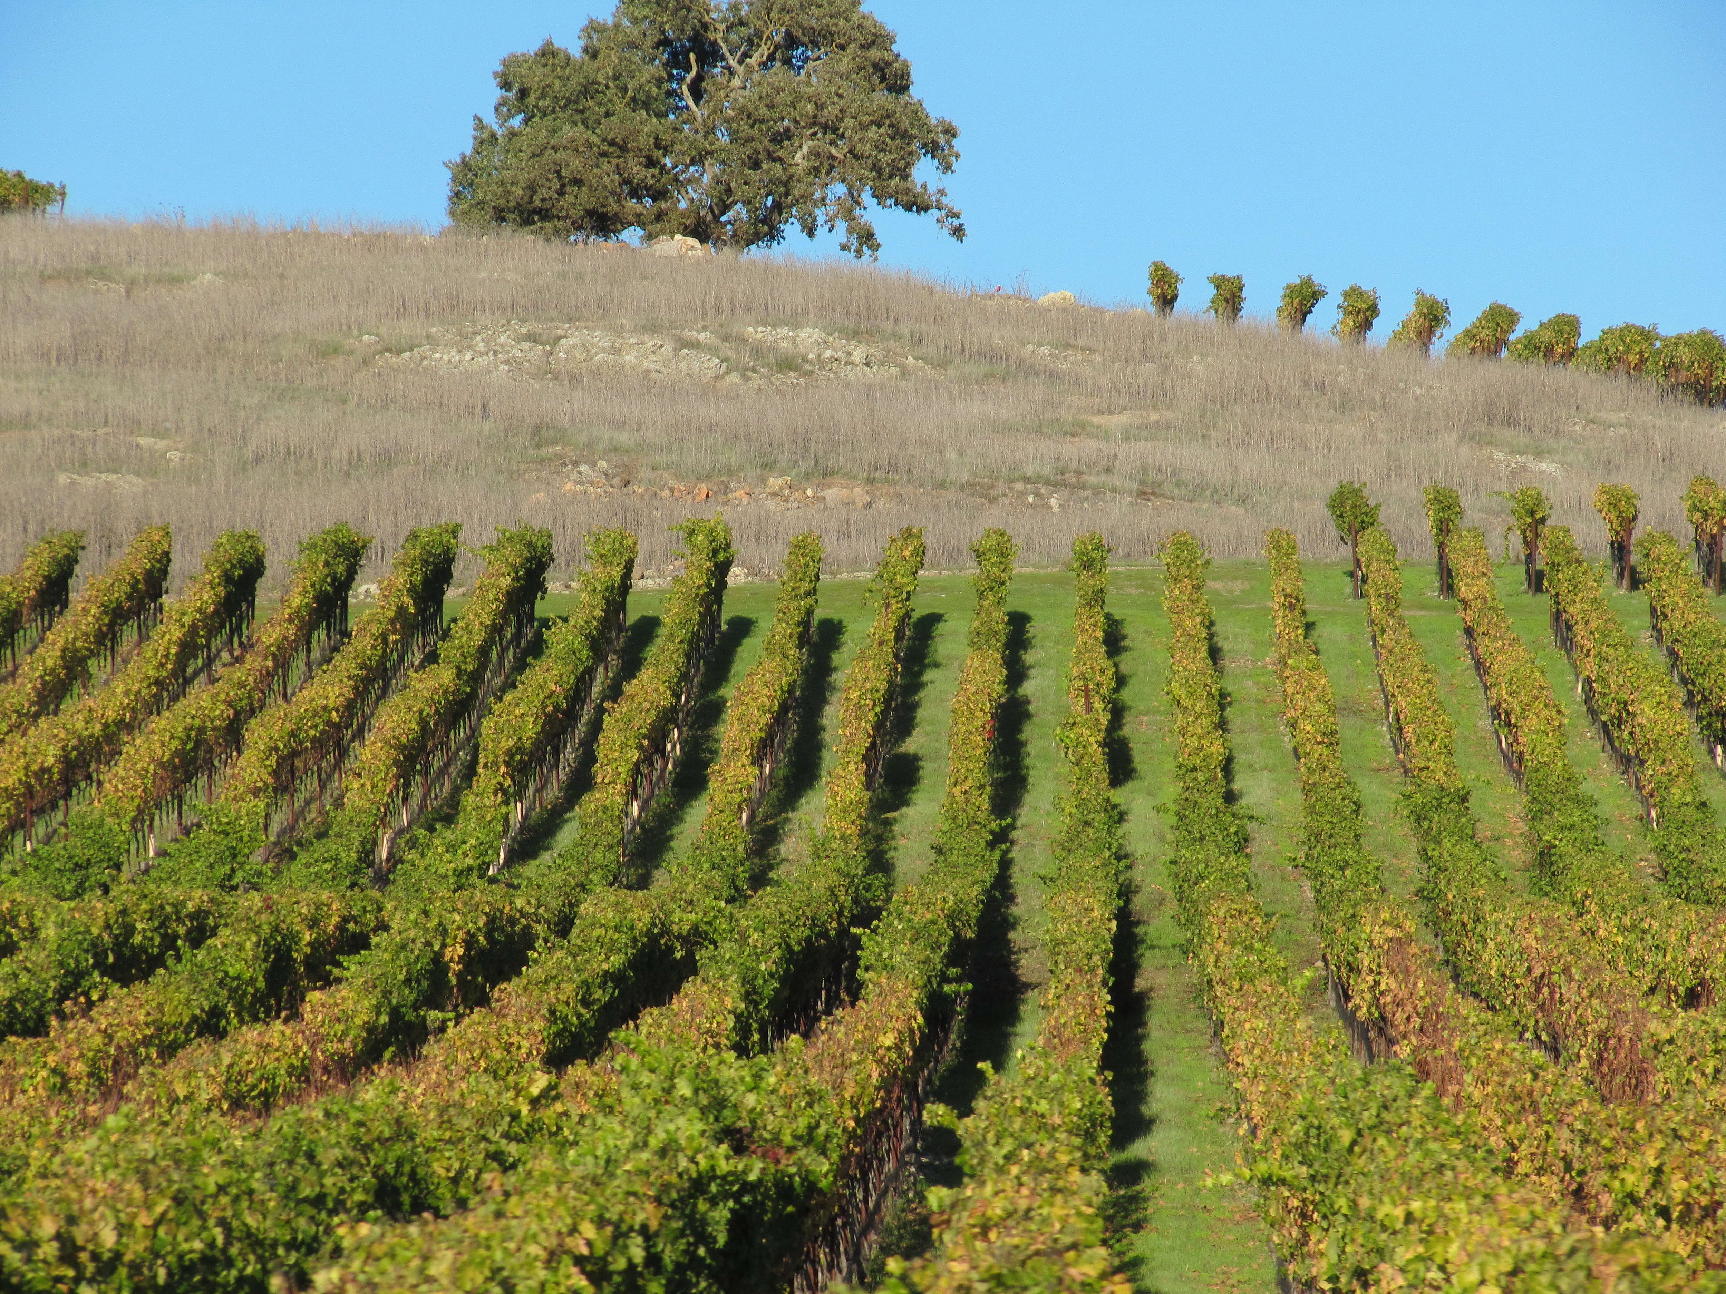
Merger
Fair Housing Napa Valley and Fair Housing Advocates of Northern California are pursuing a merger, subject to legal and regulatory approvals
The merged organization will provide Napa County residents with comprehensive fair housing services
  FHANC also serves Marin, Sonoma, and Solano Counties

Slide 20
FHANC Services
Services
Fair Housing Counseling
Training for Housing Providers & Tenants
Pre-purchase Education & Counseling
Fair Housing Investigation
Foreclosure Prevention Counseling

Slide 21
FHANC Services
Services for individuals
  Intake, counseling, investigation, and enforcement of fair housing complaints
  Fair housing education
  Housing Navigation services
  Foreclosure prevention counseling
  Pre-purchase education
FHANC provides services free of charge
FHANC provides services in English and Spanish, with translation services available in other languages

Slide 22
FHANC Services
For Housing Industry
Informational and educational programs and materials
Fair Housing Law and Practice seminars for housing providers
For the Community
Systemic audit investigations to determine compliance with fair housing laws
Education and outreach programs
Advocacy for accessible and affordable housing for all
In the Media
Bilingual press ads, public service announcements, and radio and television interviews to reach individuals protected by fair housing laws

Slide 23
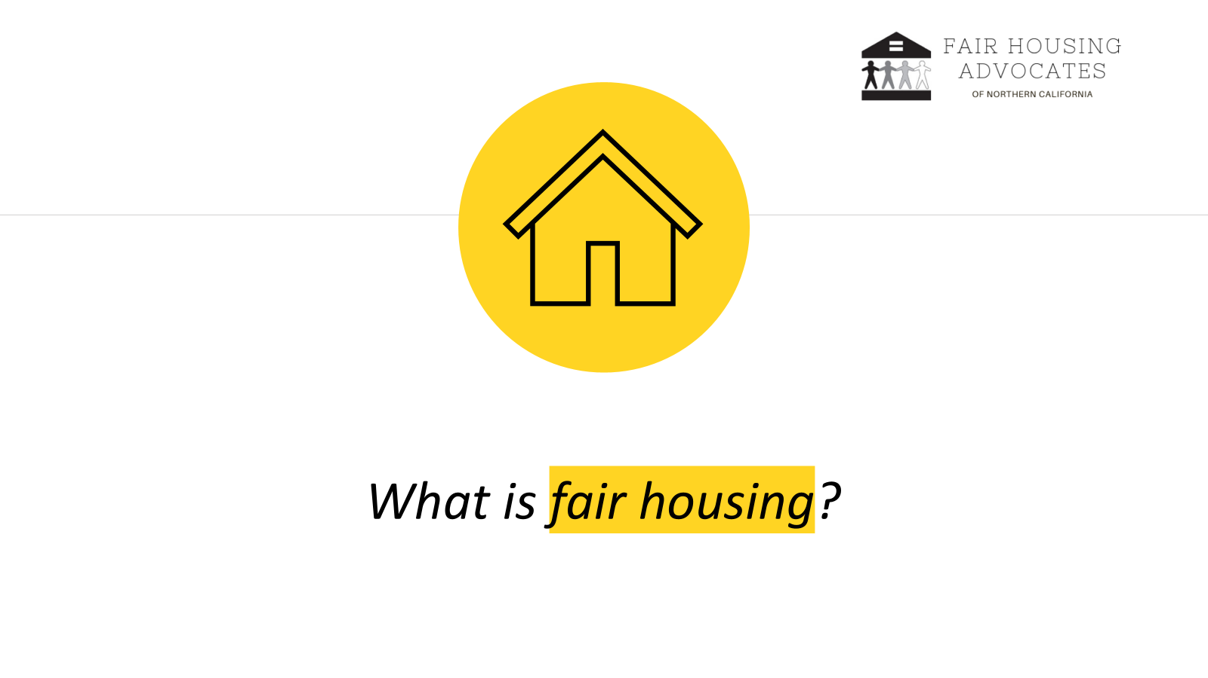
What is fair housing?

Slide 24
What is fair housing?
The ability of people of similar income levels to have available to them the same housing choices, regardless of protected characteristics
Fair housing is the right to choose housing free from unlawful discrimination

Slide 25
Protected Classes
Federally protected classes: | California adds:
Race | Marital Status
Color | Age
Religion | Ancestry
National Origin | Source of Income (includes housing subsidies and vouchers), Occupation
Sex | Genetic Information
Familial Status | Citizenship, immigration status, primary language
Disability | Arbitrary Characteristics
Notes:
This slide provides another overview of the federal and state protected classes.

Slide 26
Prohibited Activities
Prohibited if based on membership in a protected class:
  Refusal to rent, sell, or negotiate
  Discriminatory statements or advertisements that indicate a preference, limitation, or discrimination
  False representations about availability
  Steering
  Blockbusting
  Interference, intimidation, harassment, or retaliation
  Refusal to make reasonable accommodations or modifications

Slide 27
Contact FHANC
To schedule a Fair Housing training:
  Adriana Ames, Education Director
  Adriana@fairhousingnorcal.org
  (415) 457-2390
For questions about fair housing laws or FHANC’s services
  Maria Callahan, Supervising Attorney & Director of Investigations
  maria@fairhousingnorcal.org
  (415) 366-8010
To submit an intake:
  Visit our website fairhousingnorcal.org. or
  Call (415) 457-5025

Slide 28
Any questions?
Thank you!

Slide 29

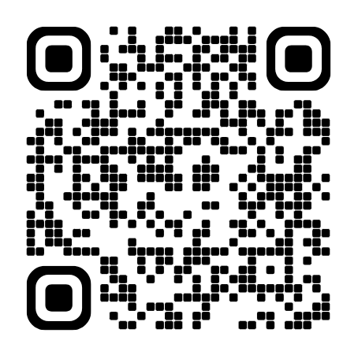
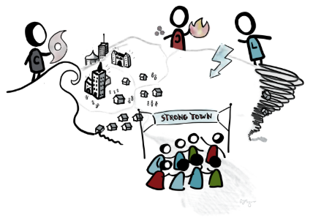
LET’S PLAY!
Ember Dodge: Neighborhood Evacuations
Creative Crisis Leadership

Slide 30
Napa Valley COAD Member Updates
Next Napa Valley COAD General Meeting
October 22, 2026 at TBD

